Slide 1
TOBAM
Bitcoin Investment Thesis and Blockchain strategy
Allfunds event
Presentation by Yves Choueifaty
Our mission: “Provide rational and professional solutions to long term investors in the context of efficient markets”
This presentation is marketing material and is not intended as a recommendation to buy or sell any particular asset class, security or strategy.
September 2024

Slide 2
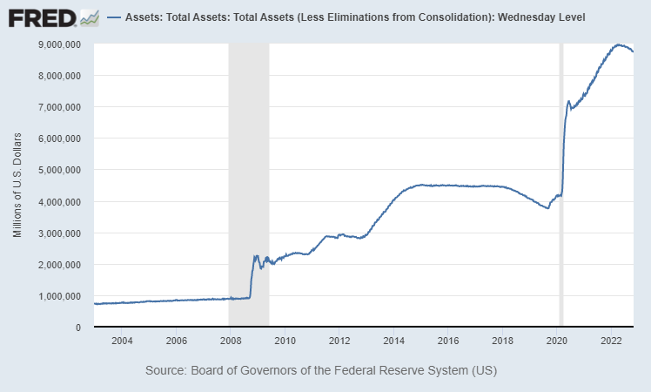
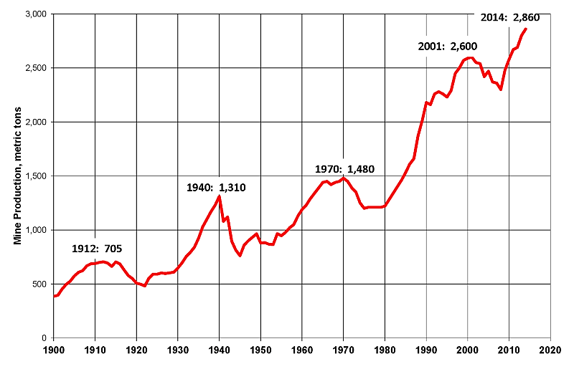
BITCOIN INVESTMENT CASE:
An answer to the problem with previous standards
HISTORY OF STANDARDS COMPARISONS
Us Federal Reserve total assets
US$ => Inflationary
Annual money supply growth +5.6% on average before 2008 and 20% per year on avg since then
Roman Denarius => Inflationary
Debasement: % of silver in the Roman Denarius went from 4 g. of silver when it was first minted. By the time it was discontinued, it contained less than 0.1 gram. Number of coins multiplied (Bretton Woods 1.0?)
Gold mine production, metric tones
Gold => Inflationary
Money supply in Gold (btw 1.1% & 2.4% per year of added supply growth)
  190 000 Tons of Gold extracted so far
Source: World mined gold production, data from USGS, as of August 17, 2015.
Bitcoin => Non-Inflationary
  5.972 10¹⁵ Tons of Gold in Planet Earth
0.00000000318151%
This information is for comparison purposes only and is not indicative of the future performance of Bitcoin
2

Slide 3
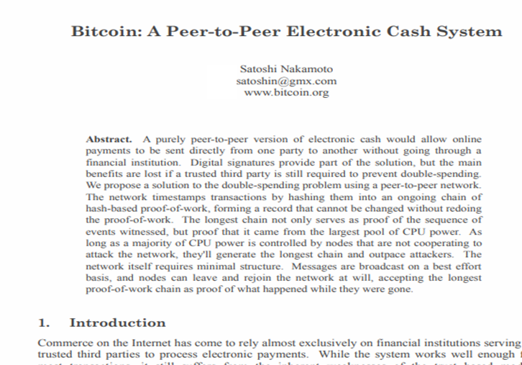
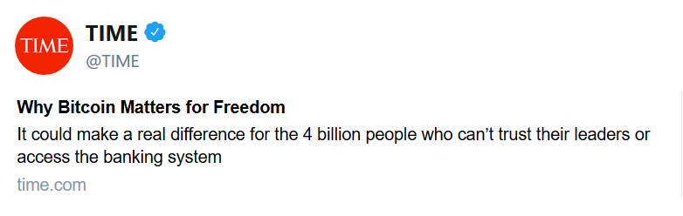
BITCOIN INVESTMENT CASE: FUNDAMENTAL CHARACTERISTICS
1-2-3. UNALTERABLE / NON-FORGEABLE / DIFFICULT TO SEIZE
Created by the pseudonymous Satoshi Nakamoto in 2008
Peer-to-peer protocol based on the Blockchain technology
Some essential characteristics of a standard:
  Unalterable
  Non forgeable
  Difficult to seize
  Non manipulated by a central authority
  Limited supply / Non inflationnary
  Exchangeable
Blockchain technology
TOBAM believes that Bitcoin has the theoretical qualities of a standard measurement of value.
3

Slide 4
BITCOIN INVESTMENT CASE: FUNDAMENTAL CHARACTERISTICS
4-5. Not manipulated, non-inflationary (1)
Bitcoin supply Growth
    Worldwide currencies are, in fact, issuable in unlimited quantities
    1 BTC= 100 million Satoshis
    Block reward:
      3.125 BTC/block (every 9-10 min) since April 2024
      Halved every 210k blocks, i.e. approximately every 4 years
      Next halving planned in 2Q28
    The amount of BTC to be issued is 21 million BTC, and its limit will be reached in 2140.
Source: TOBAM, as of 29/08/2024
4

Slide 5
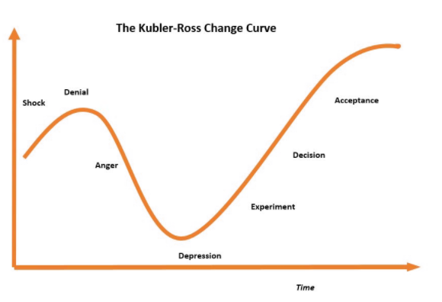
DISRUPTIVE INNOVATION SCHEME
KÜBLER-ROSS CHANGE CURVE
The Kübler-Ross Change Curve
BTC is here… in Europe
Source: Kübler-Ross Change Curve also known as the stages of grief is a model consisting of the various levels or stages of emotions which are experienced by a person who is soon going to approach death or is a survivor of an intimate death. The Kubler-Ross Model also holds true when it comes to business, societies, work or employment in the way changes are integrated.
5

Slide 6
BITCOIN INVESTMENT CASE: FUNDAMENTAL CHARACTERISTICS
Conclusion (1)
Bitcoin is well debated and discussed.
We observe 4 types of criticisms:
  Criticism driven by Passion or Ideology
  Criticism driven by Conflicts of Interest
  Criticism driven by Ignorance
  Criticism driven by Reason
✘
✘
  TOBAM believes that most criticisms driven by reason will be addressed by the emergence of a financial system between risk takers and the blockchain.
6

Slide 7
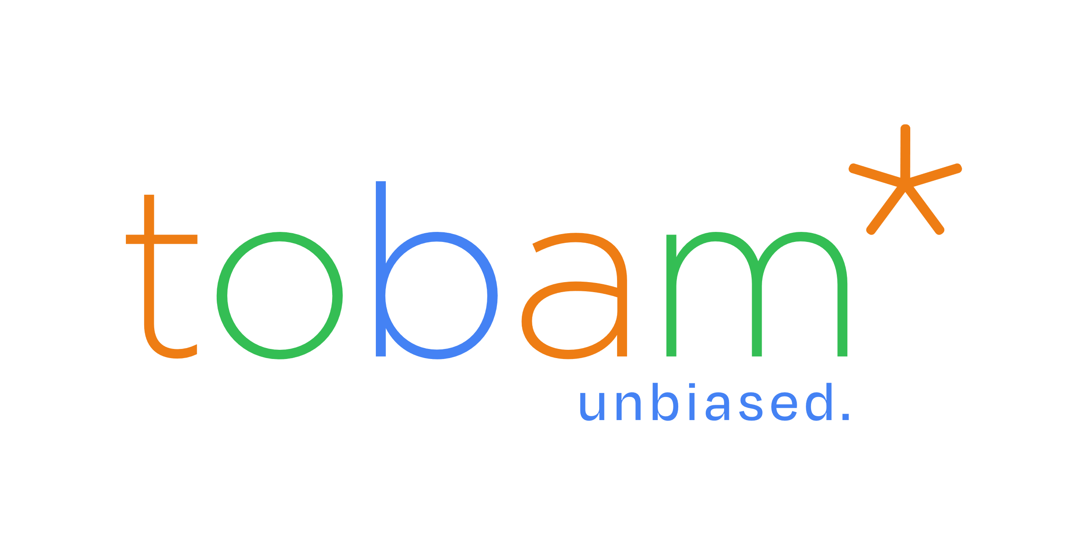
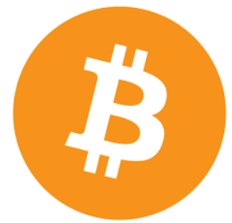
BITCOIN INVESTMENT CASE: FUNDAMENTAL CHARACTERISTICS
Conclusion (2)
Rapid development of the financial system
G:\Marketing\Company Information\Staff Information\Official CR Pic & Bio
BTC Futures
Risk takers
Mutual Funds
Exchange Traded Notes
G:\Marketing\Company Information\Staff Information\Official CR Pic & Bio
Hedge Funds
Closed end funds
BTC Platform
G:\Marketing\Company Information\Staff Information\Official CR Pic & Bio
BTC Wallet
Blockchain
7

Slide 8
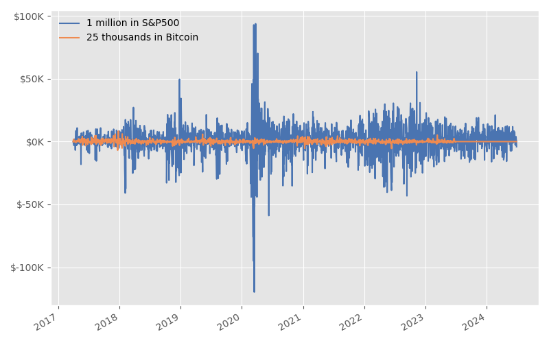
GOOD NEWS: INVESTORS ARE RISK TAKERS
Theorem:
Risk is not relevant to the Investment case.
Risk should only determine the Investment size.
US$ 1 million at 10% volatility is far riskier than US$ 25 000 at 80% volatility
% volatility is not relevant, what is relevant is the $ volatility.
“Size matters!”
The risk of an asset should determine the size of the investment, not whether to invest or not.
We should not be able to say “it is too risky for me”
The Big Dilemma:
Either buy it now, when it’s cheap and risky, or wait until it’s less risky and more expensive
Source: TOBAM and FRED. Hypothetical returns from March 31, 2017 to Jun 28, 2024 provided for illustrative purposes. Hypothetical results do not represent the results of actual trading using client assets. Warning: Past performance is not an indicator or a guarantee of future performance.
8

Slide 9
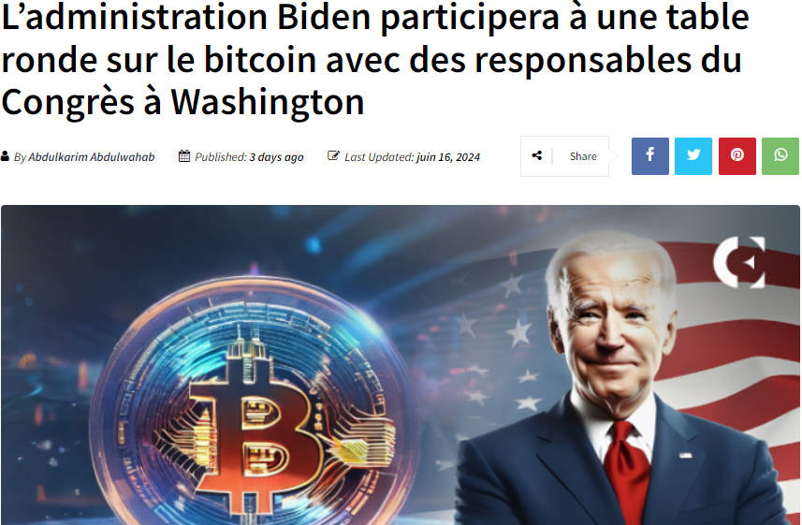
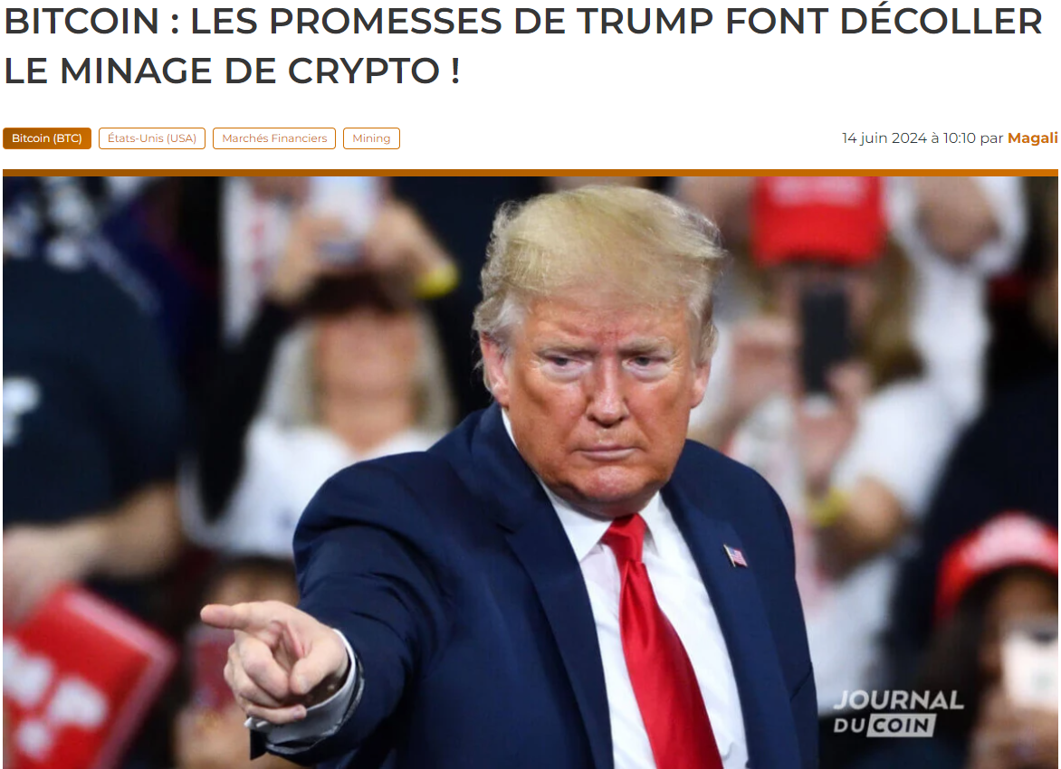
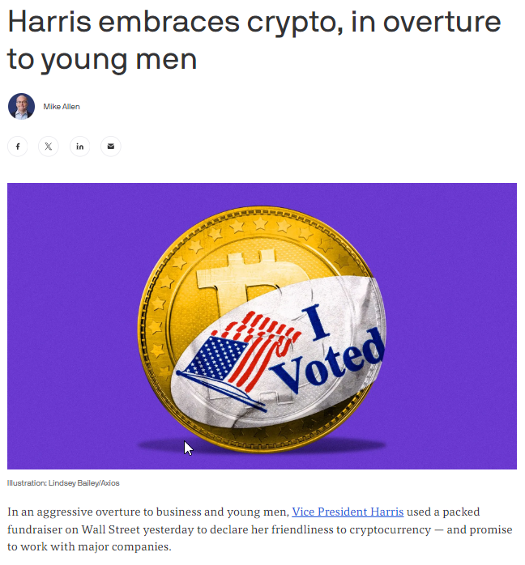
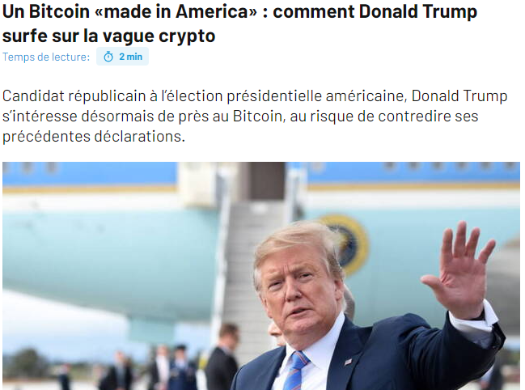
Biden administration to participate in bitcoin roundtable with congressional leaders in Washington, D.C.
“We want all the remaining Bitcoin to be MADE IN THE USA!!!
It will help us be ENERGY DOMINANT!!!”
Donald Trump, June 12, 2024
Bitcoin: Trump's promises get crypto mining off the ground
June 16, 2024
A bitcoin “made in USA”: how Donald Trump is riding the crypto wave
Republican candidate in the US presidential election, Donald Trump is now taking a close interest in Bitcoin, at the risk of contradicting his previous statements.
June 14, 2024
Sept 23rd, 2024
9

Slide 10
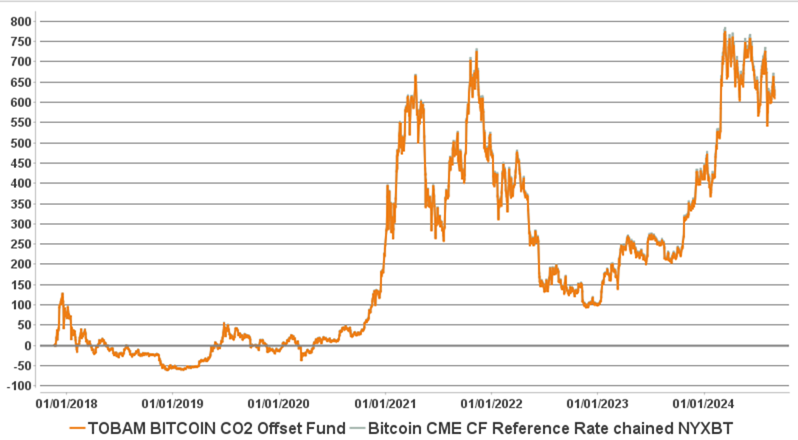
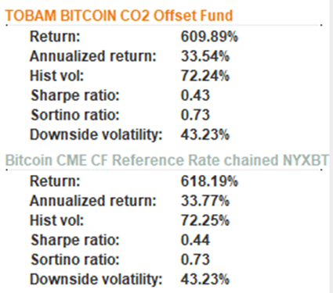
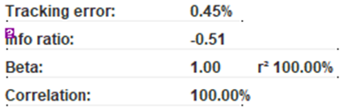
WHY TOBAM BITCOIN CO2 OFFSET FUND?
THE GOOD NEWS: ACCURATE TRACKER OF BTC
efficient: 100% correlation to bitcoin, 0.45% tracking error
Gross Performance in USD and Tracking Error
since inception (20/11/2017 – 30/08/2024)
Sources: TOBAM, Bloomberg. Returns reflect live data from November 20, 2017 to Aug 30, 2024.
Warning: Past performance is not an indicator or a guarantee of future performance. The value of your investment and income received from it can go down as well as up and you may not get back the full amount invested. Performance details provided are in USD. Performance returns and/or charts illustrating performance provided on this page are gross of management fees, sales charges and other commissions, other taxes and relevant costs to be paid by an investor are not included in the calculations. The risk free rate of return is calculated using the one month USD LIBOR rate. TOBAM Bitcoin Fund gross annualized performance between November 20, 2017 to Aug 30, 2024 is +33.5%, while the performance net of fees and transaction costs is +30.3%.
10

Slide 11
TOBAM’s Strategies
TOBAM Global Blockchain Equity Strategy
Allow all investors to exploit the potential linked to Bitcoin and blockchain adoption. 100% Equities linked to Bitcoin Launched in August 2022 AMF-Accredited funds, opened to all investors Eligibility French and Luxembourg life insurance
Cryptocurrencies and platforms are vulnerable to cyberattacks and hacking. The digital assets of the fund could also suffer from these events.

Slide 12
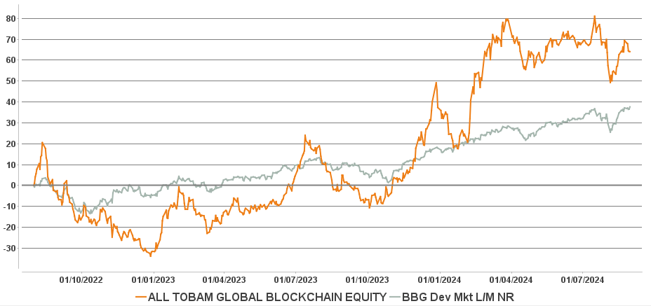


TOBAM Global Blockchain Equity Strategy
ITD LIVE RESULTS (01/08/2022 – 30/08/2024) in USD
Market cap developed world index
Market cap developed world index
Source: TOBAM and Bloomberg. Live data from 01/08/2022 until 30/08/2024. Weekly correlation calculations. Warning: Past performance is not an indicator or a guarantee of future performance. The value of your investment and income received from it can go down as well as up and you may not get back the full amount invested. Performance details provided are in USD and do not include reinvested dividends. Performance returns and/or charts illustrating performance provided on this page are Net of management fees. Sales charges and other commissions, other taxes and relevant costs to be paid by an investor are not included in the calculations.
12

Slide 13
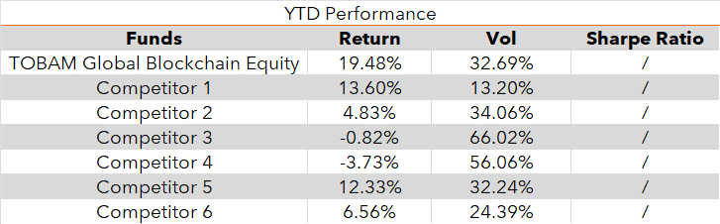
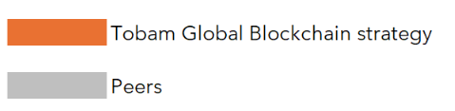
TOBAM Blockchain 2024
Source: TOBAM and Bloomberg. . Live data from 31/12/2023 until 30/08/2024. Warning: Past performance is not an indicator or a guarantee of future performance. The value of your investment and income received from it can go down as well as up and you may not get back the full amount invested.
13

Slide 14
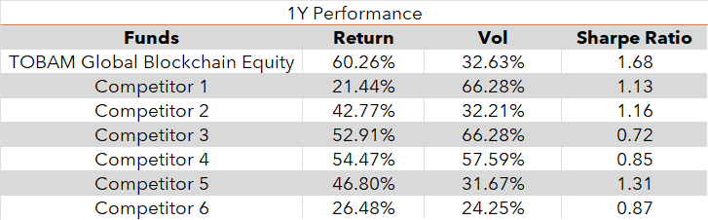
TOBAM Blockchain 1Y
Source: TOBAM and Bloomberg. . Live data from 30/08/2023 until 30/08/2024. Warning: Past performance is not an indicator or a guarantee of future performance. The value of your investment and income received from it can go down as well as up and you may not get back the full amount invested.
14

Slide 15
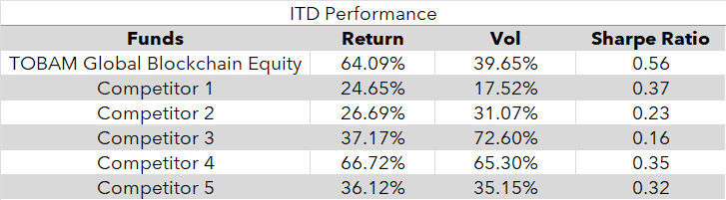
TOBAM Blockchain ITD
Source: TOBAM and Bloomberg. . Live data from 01/08/2022 until 30/08/2024. Warning: Past performance is not an indicator or a guarantee of future performance. The value of your investment and income received from it can go down as well as up and you may not get back the full amount invested.
15

Slide 16
RISKS
  Risk of capital loss: the fund does not benefit from any guarantee or capital protection. There is a risk that investors will not get back the full amount of the capital originally invested.
  Liquidity Risk: the investment strategy may involve investing in assets (i.e. Bitcoin) whose liquidity may decline sharply. In these conditions, volatility may widen significantly.
  Volatility Risk: Volatility Risk: the fund invests in Bitcoin and Blockchain related equity. There is a risk that the fund will demonstrate high levels of volatility.
  Risks linked to investment in Bitcoins: the fund invests in a highly volatile and lowly regulated asset, and due to particular factors such as platforms disruptions or regulations, the fund presents a greater degree of risk than that generally associated with investments on the major financial markets or assets.
  Cybersecurity Risk: cryptocurrencies and platforms can be subject to cyberattacks and risks of hacking. The fund by investing essentially in bitcoin might also be subject to such attacks.
  Counterparty Risk: the risk that the principal will not be returned due to the health and solvency of the party that holds the assets.

Slide 17
For professional investors only
RISKS
  Sustainability Risk: This refers to any event or situation in the environmental, social, or governance domain that, if it occurs, could have a real or potential negative impact on the investment’s value. The occurrence of such an event or situation may also lead to the exclusion of certain issuers’ securities. Specifically, the negative effects of sustainability risks can affect issuers through a series of mechanisms, including: 1) a decrease in revenues; 2) higher costs; 3) damage or depreciation of asset value; 4) higher cost of capital; and 5) fines or regulatory risks. Due to the nature of sustainability risks and specific issues such as climate change, the likelihood of sustainability risks impacting financial product returns is likely to increase in the longer term.

Slide 18
TOBAM is an asset management company offering innovative capabilities designed to maximize the benefits of scientific research to build efficient investment exposures. TOBAM’s expertise relies on 3 core pillars:
TOBAM’s Maximum Diversification® approach, supported by original, patented research and a mathematical definition of diversification, provides clients with diversified core exposure, in equity and fixed income markets.
A research driven, Solutions division (TOBAMSolutions®), dedicated to build customized solutions and services to sophisticated institutional investors,
A LBRTY® strategy range, which aims to help investors substantially mitigate their exposure to autocratic regimes in their portfolio.
In line with its mission statement and commitment to diversification, TOBAM also launched a satellite activity (CRYPTOBAM®) on cryptocurrencies in 2016.
TOBAM Maximum Diversification®, TOBAMSolutions®, TOBAM LBRTY® and CRYPTOBAM® illustrate TOBAM’s systematic “out of box” dedication to demanding investors.
TOBAM manages north of USD 4 billion (as of 30 June 2024). Its team includes 40 finance professionals based in Paris, New York and Dublin.
For more information, please visit www.tobam.fr or tobamdirect.com
18

Slide 19
This document is confidential and is intended only for the recipient. It is For institutional investors only. This report will not replace or supersede a Custodian’s official records.
This document is not an offer for sale of funds to US persons (as such term is used in Regulation S promulgated under the 1933 Act). This material is provided for information purposes only and does not constitute a recommendation, solicitation, offer, advice or invitation to enter in any transaction and should in no case be interpreted as such. The information provided relates to strategies managed by TOBAM, a French investment adviser registered with the U.S. Securities and Exchange Commission (SEC) under the U.S. Investment Advisers Act of 1940 and the Autorité des Marchés Financiers (AMF) and having its head office located at 24-26 avenue des Champs Elysées, 75008 Paris, France. TOBAM’s Form ADV is available free of charge upon request. In Canada, TOBAM is acting under the assumed name “Tobam SAS Inc.” in Alberta and “TOBAM Société par Actions Simplifiée” in Québec.
Investment involves risk, past performance is not indicative of future results, investors could lose of their investment. All investors should seek the advice of their financial advisor prior to any investment decision in order to determine its suitability.
Past performance and simulations based on backtests are not reliable indicators of future performance, forecast or prediction. Backtested data may reflect the application of the strategy methodology to historical data, and thus the strategies were constructed with the benefit of hindsight and has inherent limitations. TOBAM has continued and will continue its research efforts amending the investment process from time to time accordingly. TOBAM reserves the right of revision or change without notice, of the universe, data, models, strategy and opinions.
The constraints and fees applicable to an actual portfolio would affect the results achieved. The value and the income produced by a strategy may be adversely affected by exchange rates, interest rates, or other factors. This material, including backtests, is based on sources that TOBAM considers to be reliable as of the date shown, but TOBAM does not warrant the completeness or accuracy of any data, information, opinions or results.
The carbon impact shown is the weighted average of carbon emissions corresponding to scopes 1 and 2 of the GHG Protocol. Data on emissions used is obtained from a number of sources including company reports, CDP questionnaire (Carbon Disclosure Project) or the estimation model. The data does not take into account all emissions induced by the firm.
TOBAM’s quantitative investment process is supported by extensive proprietary computer code. TOBAM’s researchers, software developers, and IT teams follow a structured design, development, testing, change control, and review processes during the development of its systems and the implementation within our investment process. These controls and their effectiveness are subject to regular internal reviews. However, despite these extensive controls it is possible that errors may occur in coding and within the investment process, as is the case with any complex software or data-driven model, and no guarantee or warranty can be provided that any quantitative investment model is completely free of errors. Any such errors could have a negative impact on investment results. We have in place control systems and processes which are intended to identify in a timely manner any such errors which would have a material impact on the investment process.
TOBAM accepts no liability whatsoever, whether direct or indirect, that may arise from the use of information contained in this material. This document and the information herein shall not be reproduced, modified, translated or distributed without the express written permission of TOBAM or TOBAM NORTH AMERICA and to the extent that it is passed on, care must be taken to ensure that any reproduction is in a form which accurately reflects the information presented here
19

