Slide 1
TOBAM PRESENTATION
November 27, 2024 - NJV Athens Plaza
Our mission: “Provide rational and professional solutions to long term investors in the context of efficient markets”

Slide 2

LUNCH SPEAKER
Yves Choueifaty
President and Founder, TOBAM
AGENDA:
12:00 pm – 12:20 pm: welcoming participants
12:30 pm -1:45 pm: lunch-presentation
1:45 pm -2 pm: Q&A

Slide 3
Introduction to TOBAM and Anti-Benchmark
TOBAM Product Offering
Conclusion
Appendix

Slide 4

THE COMPANY
Independent and employee-owned
  Created in 2005
  Part of CalPERS’ EMD program (2011 – 2021)
  Approx. USD$ 4 billion under management
  39 financial professionals, 13 nationalities
  Regulated in France and SEC-registered
The Maximum Diversification® approach, supported by original research and a mathematical definition of diversification, provides investors with diversified core exposure, both in equity and fixed income markets.
SHAREHOLDER STRUCTURE
THE FOUNDER
Yves Choueifaty, President & CIO
(30 years investment experience), previously:
  CEO of Credit Lyonnais Asset Management (AuM €70bn)
  Graduated in 1992 from ENSAE in Statistics, Actuarial Studies Finance and Artificial Intelligence
92%
TOBAM’S EMPLOYEES
92%
8%
AMUNDI 8%
Source: TOBAM. Figures as of June 28, 2024.

Slide 5
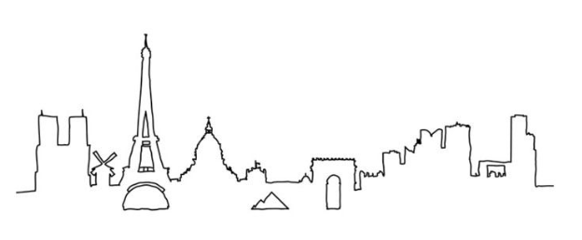
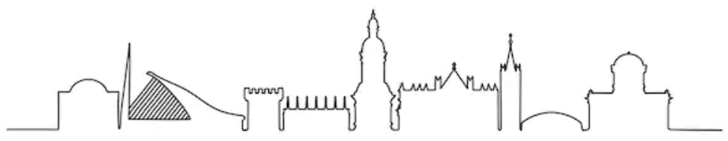
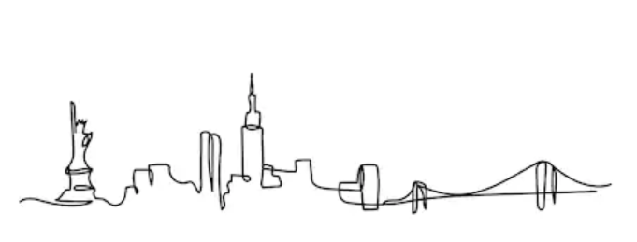
RESEARCH DRIVEN ASSET MANAGEMENT
41% of the team involved in portfolio management & research (16 people)
Identify issues, create solutions, and guarantee the rationality of solutions
Product research & development
Implementation innovation
39
employees
13
nationalities
“
The team is encouraged to think out of the box in its approach to ‘conventional wisdom’ to the greatest extent possible. As such, the team’s diversity is a critical part of how well it functions.
We have a large range of expertise, from mathematicians to engineers, economists and traders, all of which feeds in to the team’s ability to look at problems or assumptions from a very broad spectrum of viewpoints.
03
locations
Paris
Dublin
New York
“
Tristan Froidure, Head of Research

Slide 6
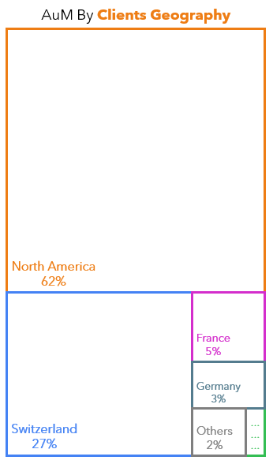
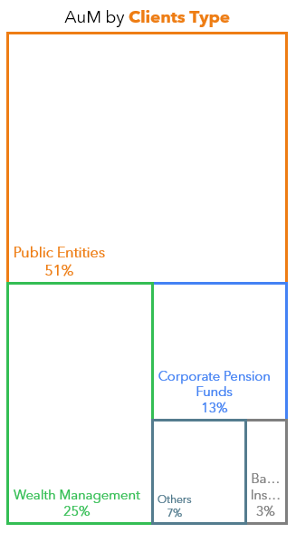
ASSETS UNDER MANAGEMENT
Key Risks: The value of your investment and the income from it will vary and your initial investment amount is not guaranteed. Allocations are subject to change.
Data as of June 28, 2024

Slide 7
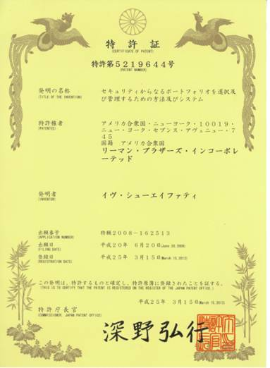
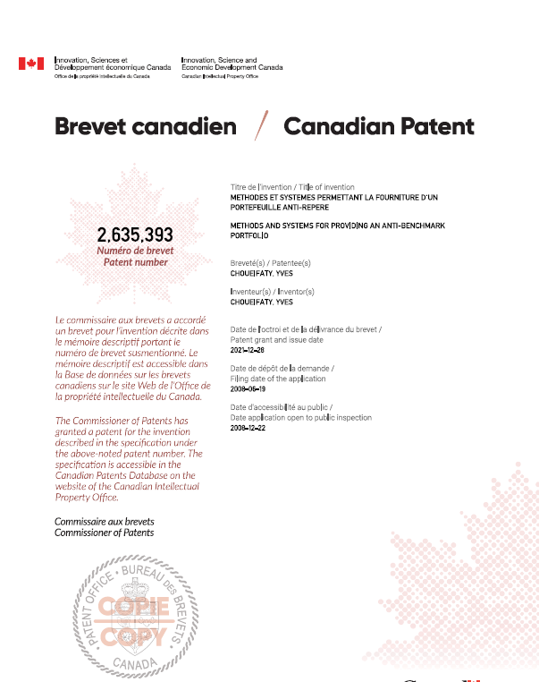
GRANTED PATENTS
US
PATENT
AUSTRALIAN PATENT
JAPANESE
PATENT
CANADIAN PATENT

Slide 8
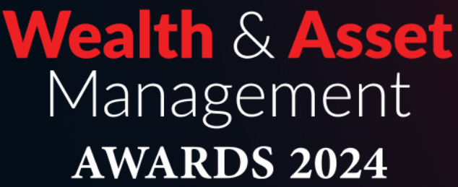





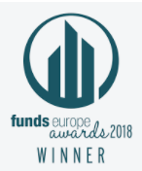





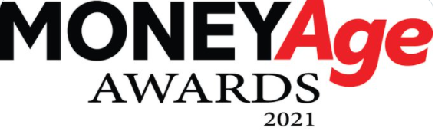





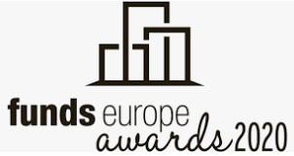



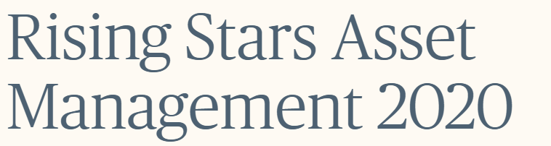
AWARDS
2023 - 2024
“Equities Manager of the year”
Wealth & AM Awards, May 2024, London
Other Awards
Multi Asset Portfolio Awards
CIO Industry Innovation Awards, Dec 2023, NYC
    “Most Sustainable Company in the Investment Industry” World Finance Sustainability Awards, 2019
    “Emerging Equity Manager of the Year”
    UK Pensions Awards 2019, London
    “European Smart Beta Manager of the Year”
    Funds Europe Awards 2018, London
    “European Asset Management Firm of the Year”
    Funds Europe Awards 2017, London
    “AM Leader of the Year”
    Grands Prix de la Gestion d’Actifs 2016, Paris
    “European Asset Manager of the Year”
    Funds Europe Awards 2016, London
    “Equities Manager of the Year”
    CIO Industry Innovation Awards 2015
    New York
    “CIO of the Year”
    Funds Europe Awards 2015
    “Profit for Non Profit Special Award, TOBAM
    Anti-Benchmark Emerging Markets Equity Fund”
    Profit for Non Profit Awards 2014, Paris
“ Grand Prix de la Philanthropie “
“Justice and Peace" category, Ficade Group, Nov 2023, Paris
2022
Multi Strategy investing Awards
CIO Industry Innovation Awards, Dec 2022, NYC
“Grand Prix de la Finance” US Equity
“Best funds to choose in the next 12 months”
H24 Finance, July 2022, Paris
“Sustainability Provider of the Year”
Asset Management Awards 2022
MoneyAge, May 2022, London
2021
“Multi Asset Manager of the Year”
European Pensions Awards 2021
October 2021, London
“Smart Beta Manager of the year”
Pension and Investment provider Awards 2021
June 2021, London
“Multi Asset Manager of the Year”
Asset Management Awards 2021
MoneyAge, May 2021, London
2020
    European Asset Management Firm of the Year” (assets under €20bn)
    Funds Europe Awards 2020, London
    TOBAM’s Anti-Benchmark® Multi Asset:
    “Best Flexible Fund”
    Grands Prix de la Gestion d’Actifs 2020, Paris
    “Emerging Equity Manager of the Year”
    Pension Age Awards 2020, London
    TOBAM’s Deputy CIO elected in the Top 25 Rising Stars of Asset Management
    Financial News, September 2020

Slide 9
Introduction to TOBAM and Anti-Benchmark
TOBAM Product Offering
Conclusion
Appendix
2006: Maximum Diversification®
2017: CRYPTOBAM®
2023: LBRTY®

Slide 10

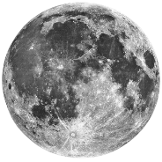
Migrating TOBAM from a Mono-Core …
…. To Multi-Core
LBRTY®
TOBAMSolutions®
Maximum Diversification®
CrypTOBAM®

Slide 11
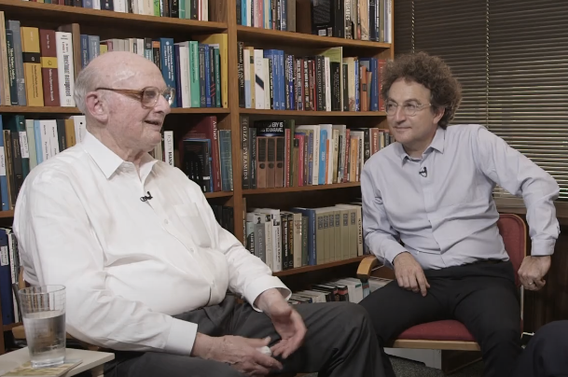
The “MAXIMUM DIVERSIFICATION®” APPROACH
Maximum Diversification®: a quantitative investment approach based on a unique principle – building the Most Diversified Portfolio®
The MDP® portfolio objective: outperform the market cap index with less risk, by increasing diversification
  Definition of a mathematical measure of a portfolio’s diversification:
  the Diversification Ratio® (patented),
  Set up of an investment process that increases this Diversification Ratio®,
  Long-only, non leveraged and fully invested
The MDP®:
  neutrally allocates risk to the effective independent sources of risk,
  Attempts to be the undiversifiable portfolio,
  provides a theoretical definition of the market risk premium
TOBAM Founder Yves Choueifaty meeting with Dr. Harry Markowitz, Nobel Prize winner (San Diego - June 2019)

Slide 12
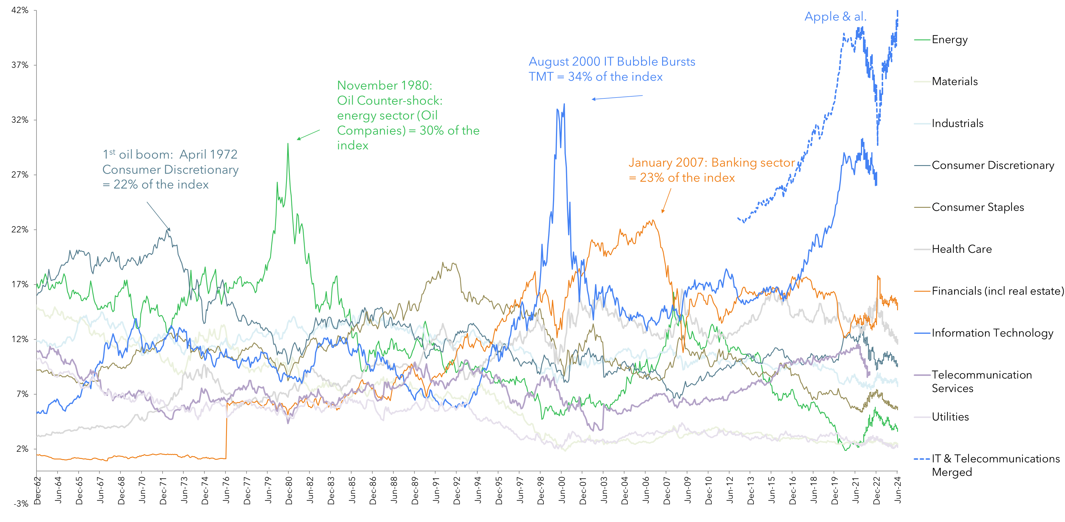
CAP-WEIGHTED INDICES TAKE ON HEAVY STRUCTURAL BIASES…
As stocks appreciate, the greater their index representation, and conversely so
The greater the imbalance, the greater the impact of changes in price (volatility)
Using a biased benchmark as a reference carries heavy (and costly) implicit bets
These implicit bets evolve dynamically over time
US Equity Market - Sector Weights
Source: TOBAM calculations - Figures as of June 28, 2024. Key Risks: The value of your investment and the income from it will vary and your initial investment amount is not guaranteed. Allocations are subject to change. Of note, GICS introduced a new sector classification in September 2018, that impacted US sector weights. Please contact us for TOBAM’s view on the reclassification and access to our dedicated dashboard on the topic.

Slide 13
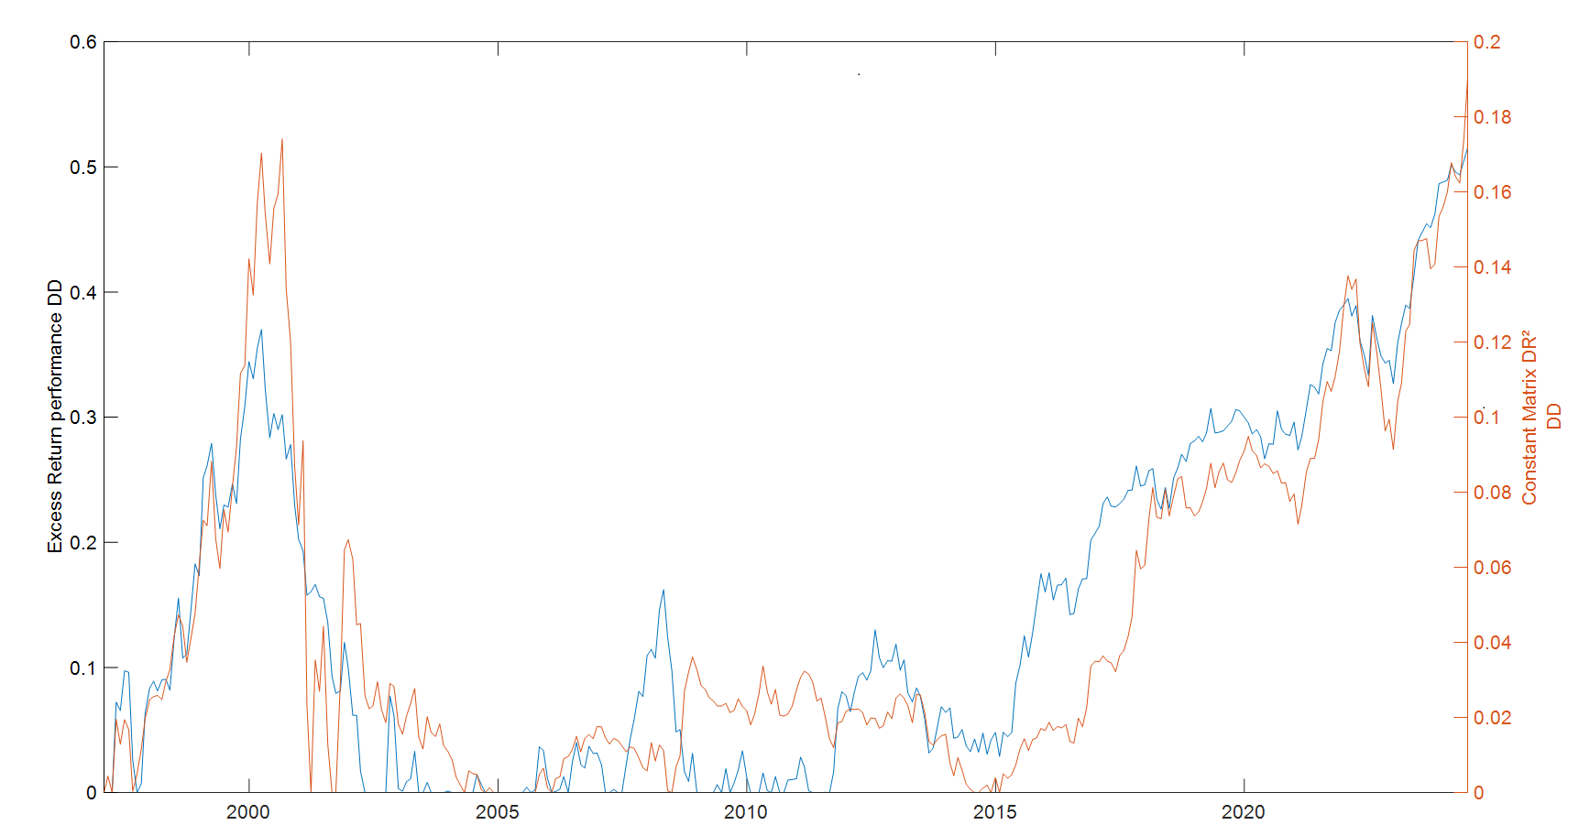
VALUE PROPOSAL
Case of US strategy
+76% excess return
+5% excess return
+67% excess return
Concentration –Deconcentration Cycle 1
12/31/96 – 6/30/04
Concentration –Deconcentration Cycle 2
6/30/04 -6/30/08
Concentration –Deconcentration Cycle 3
6/30/08 -3/31/15
Concentration only Cycle
12/31/15 to date
Significant prolonged increase in concentration
Source: TOBAM, BBG, December 31, 1996 to June 28, 2024.
Constant Matrix DR² Drawdown
Excess Return Drawdown

Slide 14
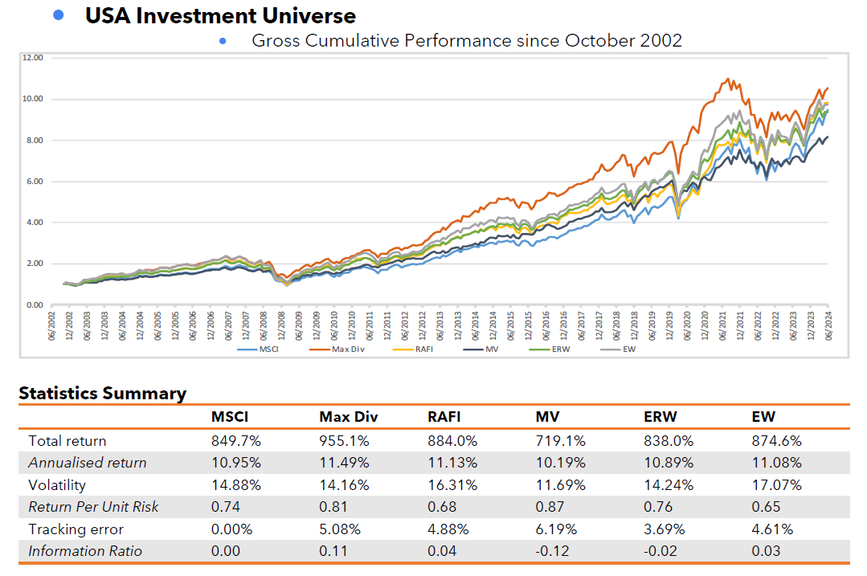
MAXDIV PERFORMANCE COMPARISON
Source: TOBAM and Bloomberg. Returns are gross of fees and stated in USD, net returns are not available for indices. One cannot invest directly in an index. An investment in a vehicle tracking an index would include amongst other things, advisory fees and expenses. Performance information for TOBAM Maximum Diversification® indices are based on back tested returns from October 2002 to November 2011, live data has been used from launch in November 2011 to June 2024.
Performance information for TOBAM Diversified Benchmark indices are based on back tested returns for the entire period presented.
Back tested results are for information purposes only. They are intended to illustrate how the strategy may have behaved over the period prior to it being launched. Past performance is not indicative of future results. Please see the disclaimer page located at the end of this note for important additional disclosures.

Slide 15
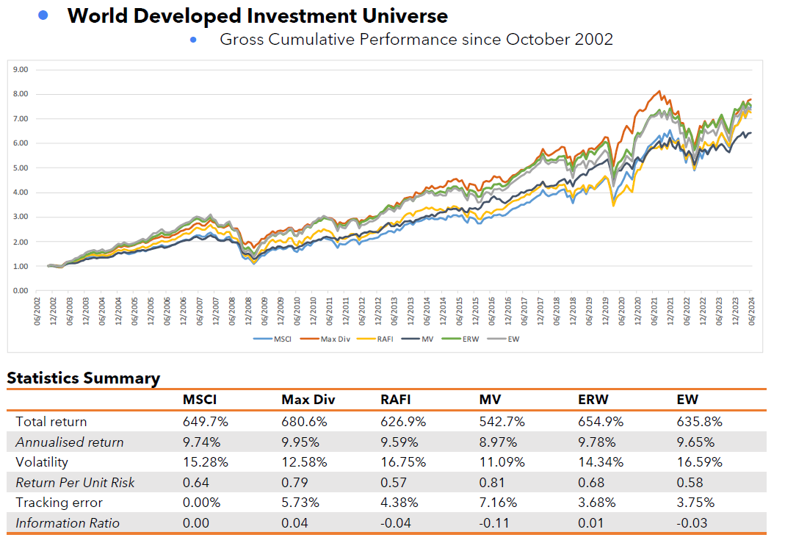
MAXDIV PERFORMANCE COMPARISON
Source: TOBAM and Bloomberg. Returns are gross of fees and stated in USD, net returns are not available for indices. One cannot invest directly in an index. An investment in a vehicle tracking an index would include amongst other things, advisory fees and expenses. Performance information for TOBAM Maximum Diversification® indices are based on back tested returns from October 2002 to November 2011, live data has been used from launch in November 2011 to June 2024.
Performance information for TOBAM Diversified Benchmark indices are based on back tested returns for the entire period presented. Back tested results are for information purposes only. They are intended to illustrate how the strategy may have behaved over the period prior to it being launched. Past performance is not indicative of future results. Please see the disclaimer page located at the end of this note for important additional disclosures.

Slide 16
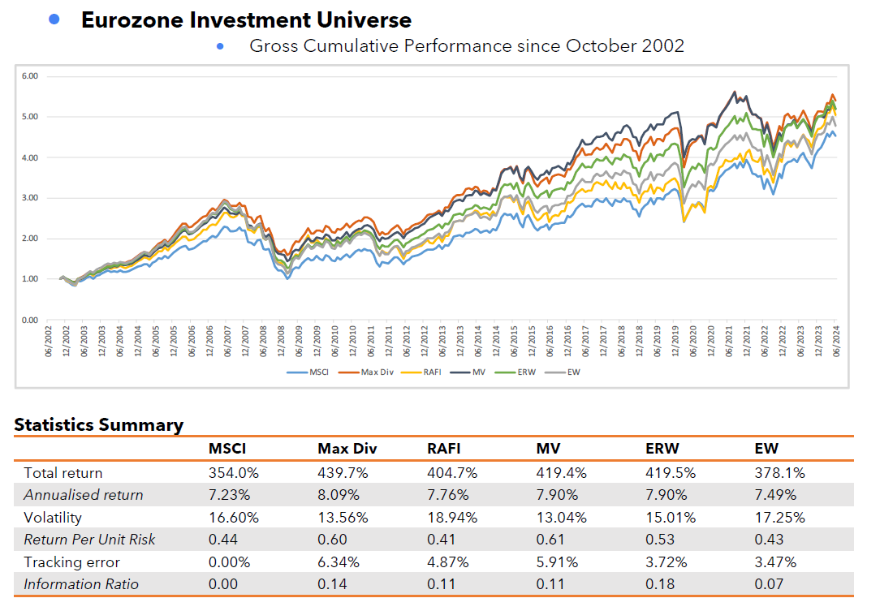
MAXDIV PERFORMANCE COMPARISON
Source: TOBAM and Bloomberg. Returns are gross of fees and stated in EUR, net returns are not available for indices. One cannot invest directly in an index. An investment in a vehicle tracking an index would include amongst other things, advisory fees and expenses. Performance information for TOBAM Maximum Diversification® indices are based on back tested returns from October 2002 to November 2011, live data has been used from launch in November 2011 to June 2024.
Performance information for TOBAM Diversified Benchmark indices are based on back tested returns for the entire period presented. Back tested results are for information purposes only. They are intended to illustrate how the strategy may have behaved over the period prior to it being launched. Past performance is not indicative of future results. Please see the disclaimer page located at the end of this note for important additional disclosures.

Slide 17
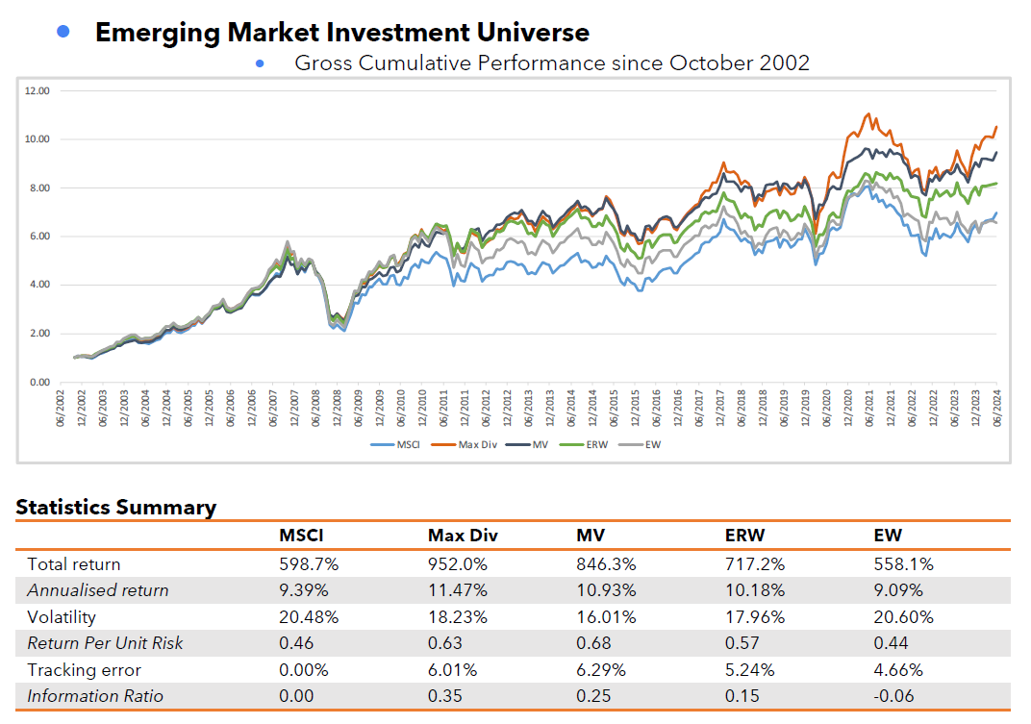
MAXDIV PERFORMANCE COMPARISON

Slide 18
Introduction to TOBAM and Anti-Benchmark
TOBAM Product Offering
Conclusion
Appendix
2006: Maximum Diversification®
2017: CRYPTOBAM®
2023: LBRTY®

Slide 19
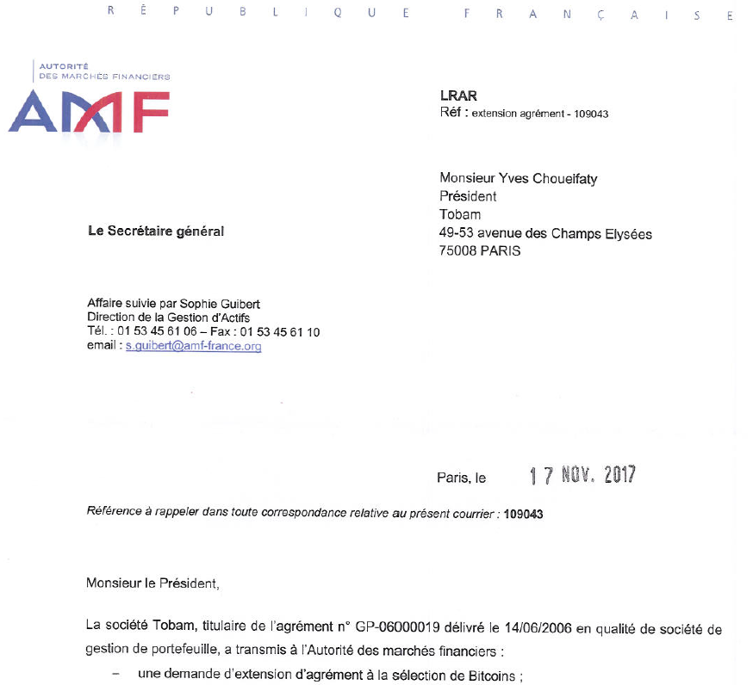

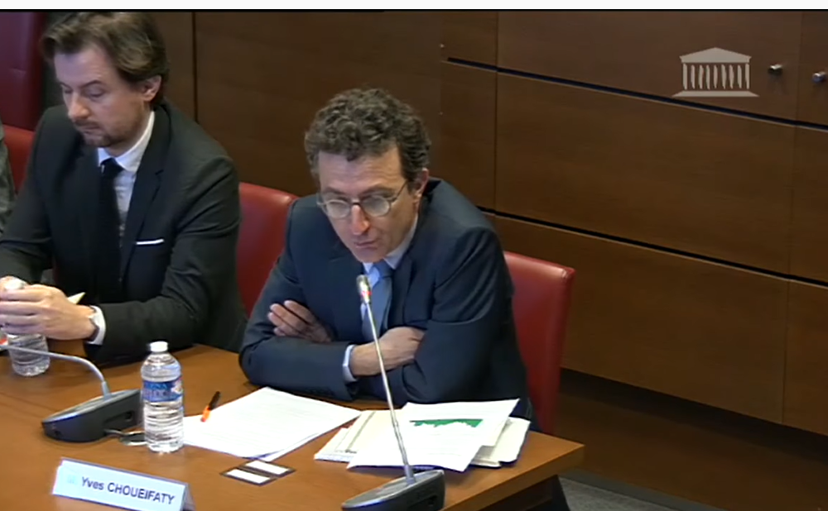
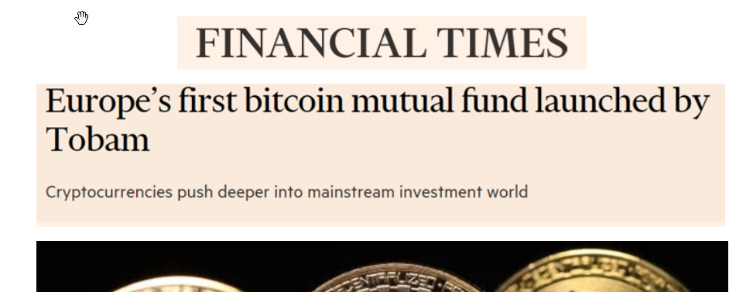
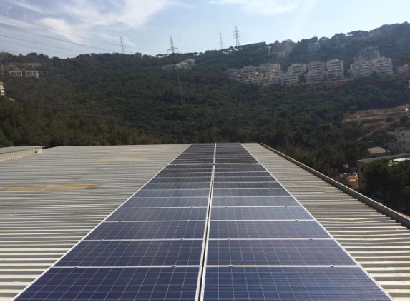
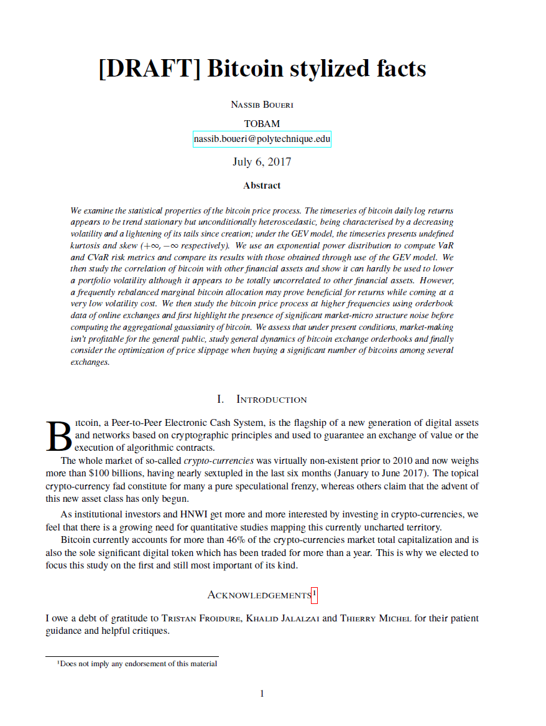
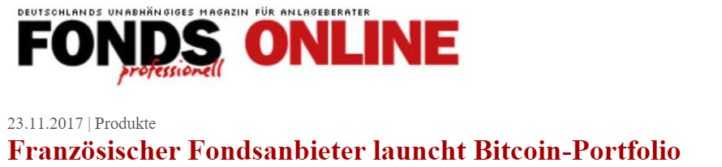
For institutional investors only
TOBAM’S JOURNEY INTO CRYPTO
First DeFi Mandate
+
Bitcoin-related Equity bucket in AB Multi-Asset
Launch of a next generation BTC Fund eligible to FR Unit-Linked
Launch of the first white-labelled fund with direct multi-crypto exposure
First BTC Investment by a TOBAM Employee
Launch of the "Crypto Research Project"
First
BTC Mandate
Launch of the first Bitcoin open-ended Fund in the world
Zero
Carbon
Mine Inaugurated
Team hiring finalized
Launch of TOBAM Global Blockchain equity
2013
2016
Mar.
2017
Sep.
2017
Nov.
2017
Sep.
2018
April
2021
Sept.
2021
Nov.
2021
Sept
2023
Research projects
Market impact Forks CO2 Time Diversification Crypto Anti-Benchmarks …

Slide 20
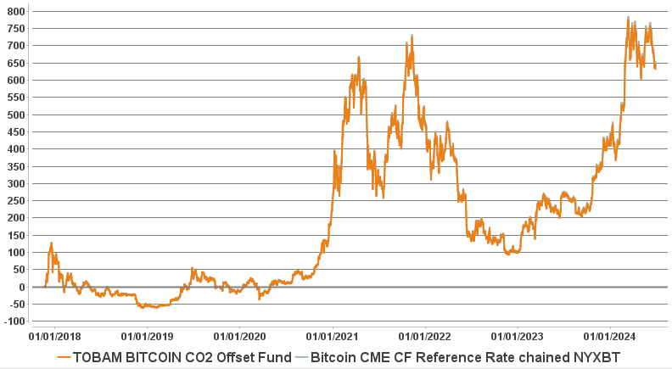
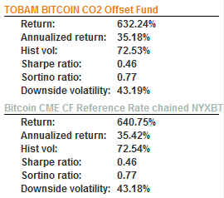

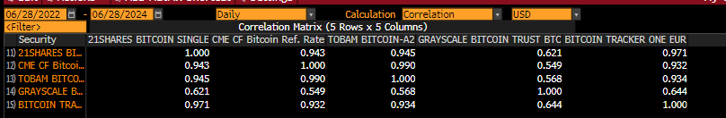
WHY TOBAM BITCOIN CO2 OFFSET FUND?
THE GOOD NEWS: ACCURATE TRACKER OF BTC
Gross Performance in USD and Tracking Error
since inception (20/11/2017 – 28/06/2024)
Sources: TOBAM, Bloomberg. Returns reflect live data from November 20, 2017 to Jun 28, 2024.
Warning: Past performance is not an indicator or a guarantee of future performance. The value of your investment and income received from it can go down as well as up and you may not get back the full amount invested. Performance details provided are in USD. Performance returns and/or charts illustrating performance provided on this page are gross of management fees, sales charges and other commissions, other taxes and relevant costs to be paid by an investor are not included in the calculations. The risk free rate of return is calculated using the one month USD LIBOR rate. TOBAM Bitcoin Fund gross annualized performance between November 20, 2017 to Mar 28, 2024 is 40.2%, while the performance net of fees and transaction costs is +36.7%.
20

Slide 21
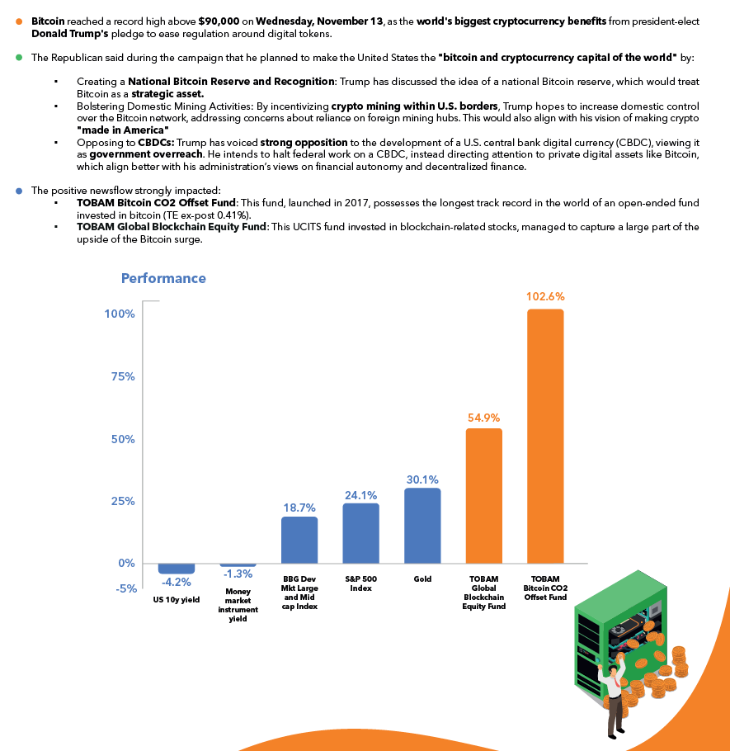
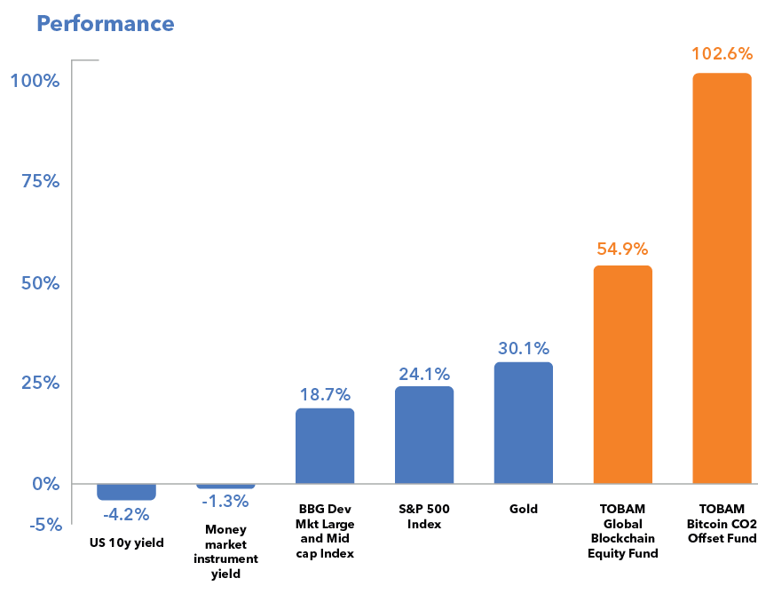
BLOCKCHAIN AND BITCOIN:
RIDING THE WAVE POST US ELECTIONS
21

Slide 22
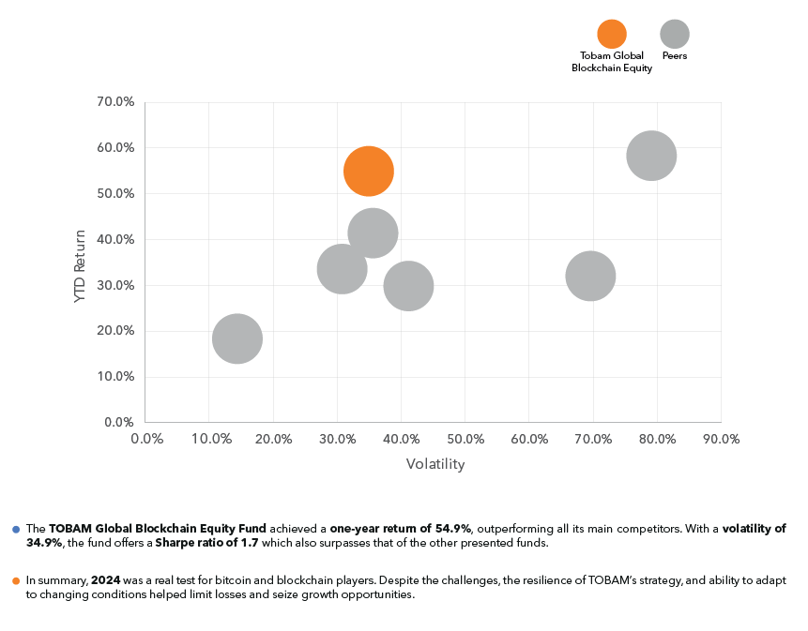
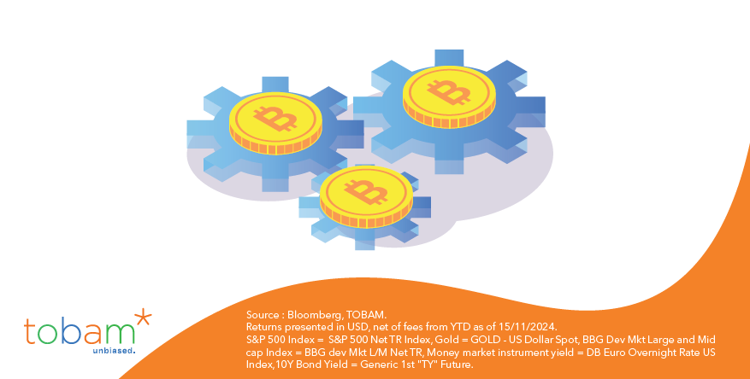
BLOCKCHAIN AND BITCOIN:
RIDING THE WAVE POST US ELECTIONS
22

Slide 23
Introduction to TOBAM and Anti-Benchmark
TOBAM Product Offering
Conclusion
Appendix
2006: Maximum Diversification®
2017: CRYPTOBAM®
2023: LBRTY®

Slide 24



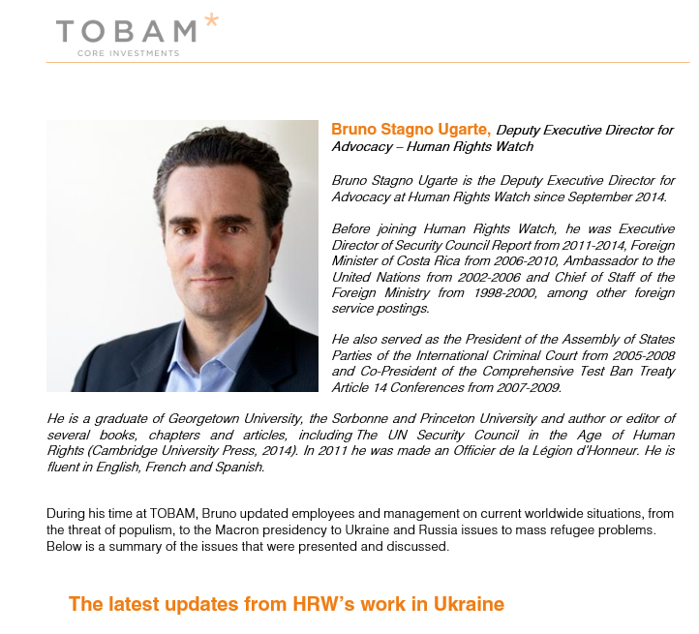
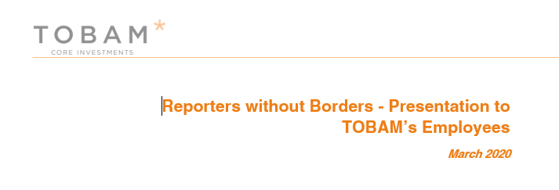

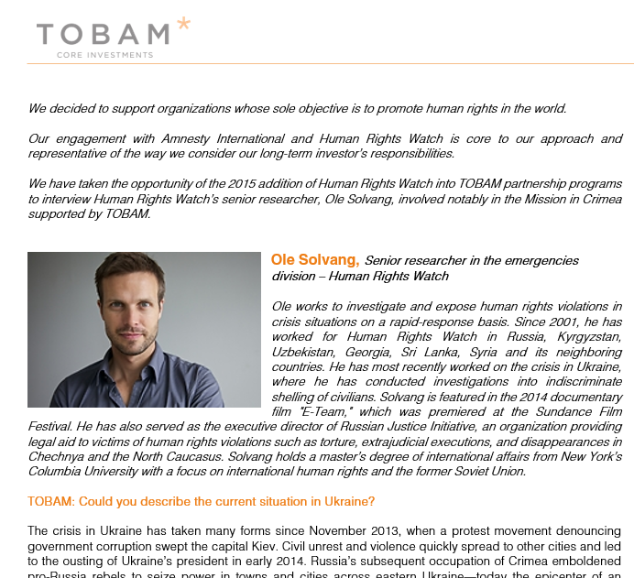

TOBAM’s commitment to Human Rights
ADDRESSING THE AUTOCRACY risk
TOBAM’s Journey into Human Rights
2009
TOBAM chooses Human Rights as its philanthropy field.
First donation to Amnesty International
2010
TOBAM becomes signatory of the United Nations Global Compact
2011
Set up Systematic Revenue-Linked Donation Program (AB EM)
2015
Onboarding of Human Rights Watch In TOBAM’s Donation Process
Ukraine project
2016
Promotion and Education around Human Rights Key Challenges
Conferences, Interviews, Webinar, Internal presentation
2018
2019
2020
Onboarding of Reporters without Borders
Fundraising Campaign after the Blast in Beirut
2021
Fundraising Campaign for Ukraine in coordination with HRW
2023
Launching LBRTY®, first fund focused on Civil Rights & Democracy

Slide 25
TOBAM’s commitment to civil rights & democracy
ADDRESSING THE AUTOCRACY risk Driver …because it works
Our convictions:
It is about creating value in the long run
It is not about being philanthropic with investors’ money
It is about integrating what contributes to value creation and removing what contributes to value destruction
It is not about discriminating between evil and good; it is about promoting what works, what lasts and will survive on the long run and what will create value
Democracy, Respect of Human Rights, Freedom of Speech, Promotion of Diversity and Pluralism are key to innovation, creativity and economic growth
Not “Good” “vs “evil”
But “what works” vs “what doesn’t work”

Slide 26
Introduction to TOBAM and Anti-Benchmark
TOBAM Product Offering
Conclusion
Appendix
2023: LBRTY®
  Investment Philosophy – The case for Civil and Democratic Rights

Slide 27

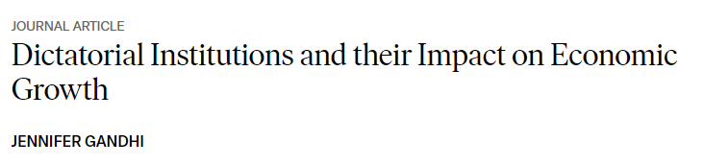
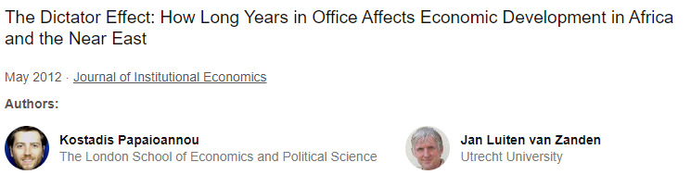
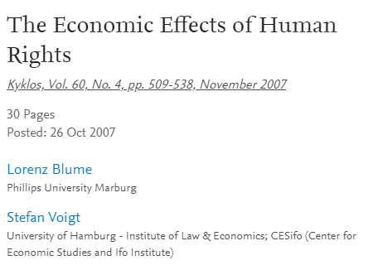
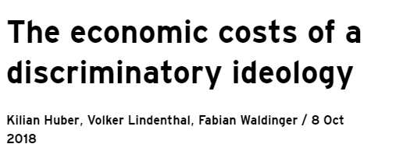
Investment philosophy
Numerous research have demonstrated the cost of dictatorship and lack of civil liberties
In the long-run investors in countries with oppressive regimes and arbitrary rules are exposed to unrewarded risks.
Notably due to arbitrary state behaviour, uncompensated expropriations, social unrest, corruption, war…. In the long run they will underperform others.

Slide 28
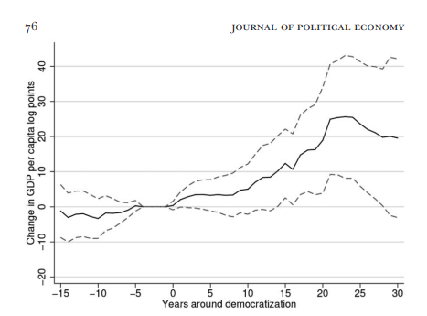

DEMOCRACY DOES CAUSE GROWTH (ACEMOGLU, ROBINSON & AL. 2019)…
Acemoglu & al (2019) identify 122 democratizations and 71 reversals from democracy based on data from 1960 until 2010 and show that:
There is a positive causal effect of democracy on economic growth.
A country that transitions from nondemocracy to democracy achieves about 20 percent higher GDP growth per capita in the next 25 years than a country that remains a nondemocracy.
It drives greater investments in capital, schooling, and health.
The effect of democracy does not depend on the initial level of economic development/level of income.
NOBEL PRIZE IN ECONOMIC SCIENCES
October 2024 update
Source: TOBAM, Acemoglu et al 2019
The solid line plots the estimated average effect on GDP per capita on countries that democratized (in log points), with a 95 percent confidence interval in dashed lines

Slide 29
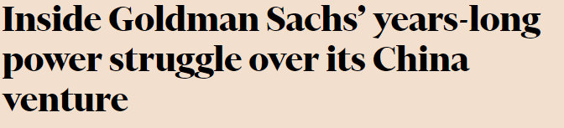
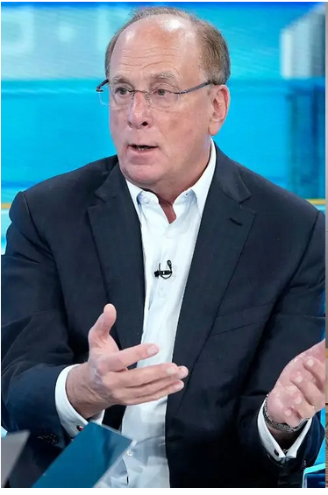
BUSINESS WILL EXIT CHINA AS AUTOCRACIES HINDER THEIR OPERATIONS
BlackRock’s Fink calls for Western firms to question ties with China :
  “Each country, each company, has to reassess what that means”
  “We all have to re-evaluate that, like we have to re-evaluate a risk in liquidity traps, a risk in everything” when operating in autocratic regions
Source: FT, November 14, 2024
A cautionary tale for Western institutions:
Goldman Sachs partnered with Fang a Chinese investment banker, expecting the alliance to last briefly until they could directly own their Chinese securities and investment banking business…
…The deal lasted two decades, benefiting Fang and leaving Goldman eager to exit.
"We have businesses in China, I'm sure everybody here has some businesses in China […] We all have to re-evaluate that“
BlackRock CEO Larry Fink,1st October 24
Berlin Global Dialogue conference
Source: John Lamparski via Getty Images

Slide 30
Launching first fund focused on civil rights & democracy
ADDRESSING THE autocracy risk
Identifying the “autocracy risk driver”
Building a portfolio under exposed to the autocracy risk
There is an autocracy risk driver
This risk driver is negatively rewarded
Most of the exposure to the autocracy risk driver is indirect
The autocracy risk driver is independent from other risk drivers

Slide 31
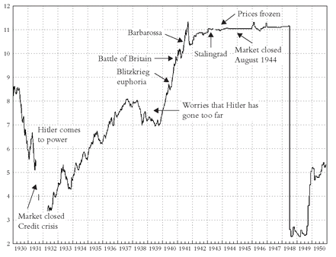
Yves Choueifaty: “BEING EXPOSED TO AUTOCRACY, CONSIST INTO BEING EXPOSED TO A REVERSE J-CURVE.”
US Stock market: 1930-1950
Example of Reverse J-Curve:
Germany 1933-1943
Germany’s stock market experienced a sharp rise from 1939 to 1943 .
This rise was not present in the US market.
From 1944, prices were frozen, and it was impossible to get out from the German stock market.
The German stock market re-opened in mid-1948 with a fall of ~80% (+inflation).
Germany CDAX Index: 1930-1950
Impossible to exit
Source: Wealth, war and wisdom, by Biggs, Barton, John Wiley & Sons, 2009.

Slide 32
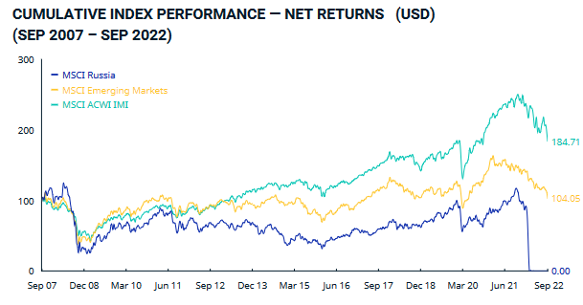
Reverse J-Curve: THE CASE OF RUSSIA
The potential instability of non-democratic countries makes them more susceptible to black swan events.
One of the most recent example being Russia where direct investments in stocks/bonds of companies in Russia or in companies located elsewhere but with significant economic ties to Russia have been a very painful experience for investors.
Russia is a country classified as authoritarian since 2011.
Source: TOBAM, MSCI

Slide 33
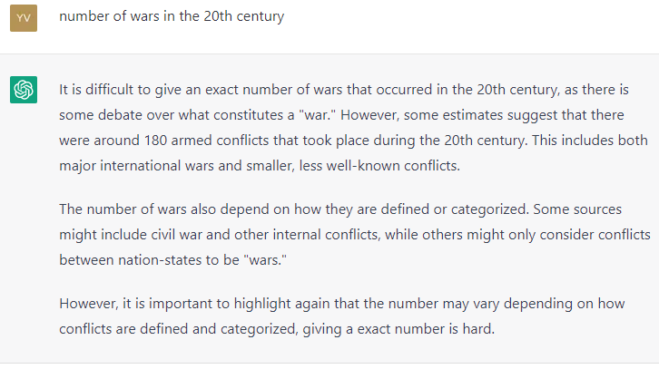
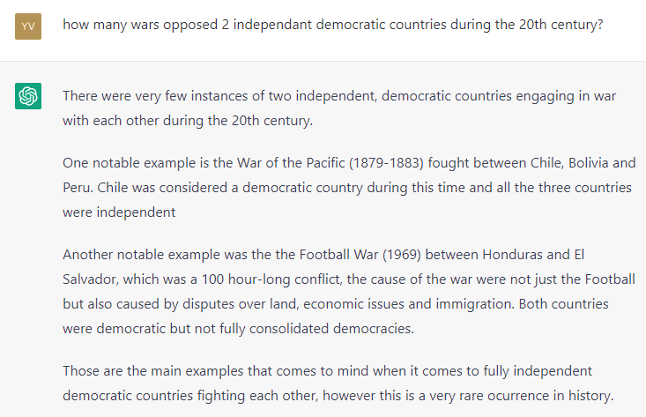
DEMOCRACIES AND WARS IN THE 20TH CENTURY ACCORDING TO… CHATGPT
Source: ChatGPT as of January 23rd, 2023

Slide 34

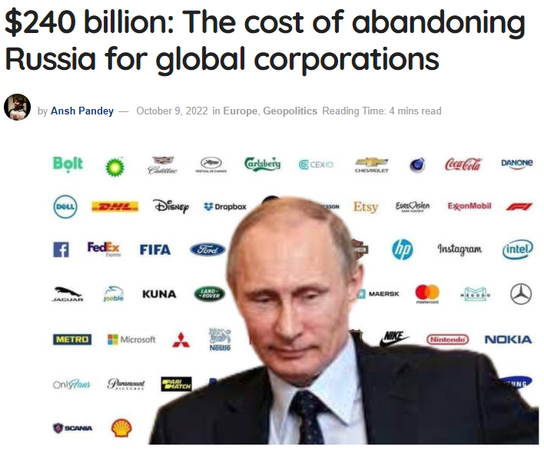
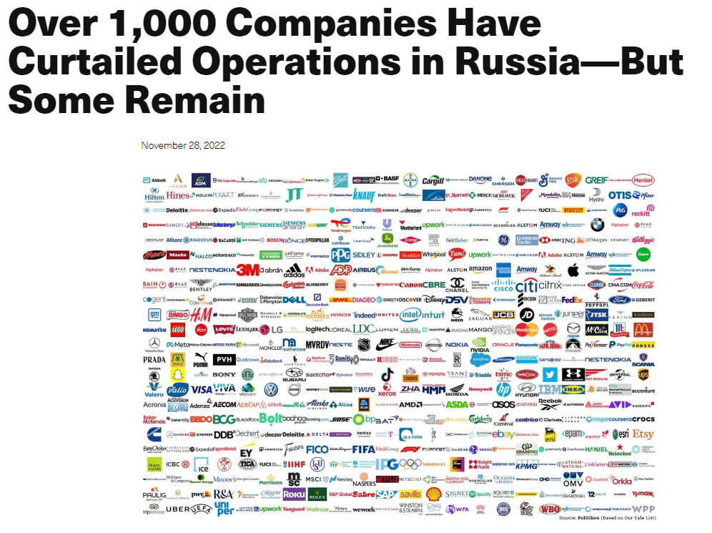
WEAR YOUR CORRELATION GLASSES ! ! !
Source: Yale University, as of Nov 28th, 2022
Source: https://tfiglobalnews.com/

Slide 35
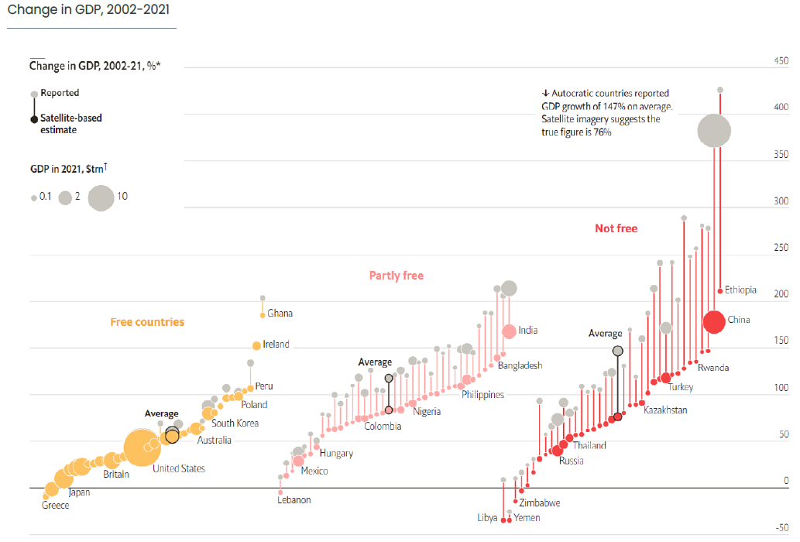
We should not trust the dictators’ GDP growth estimates (L.R. Martinez, 2022)
GDP growth reported by autocracies are inflated by up to 35% per annum on average.
In the long run, the reported GDP growth numbers nearly doubled the autocracies' actual economic growth.
Source: The Economist, 1-7 October 2022, p.77; “How much should we trust the dictators’ GDP growth estimates?”, L.R. Martinez, 2022; Freedom House; World Bank.
*In 2021 USD at market exchange rates, assuming reported 1992 GDP figures are accurate.
+Countries with over 5 million people, freedom status in 2021.

Slide 36
For institutional investors only
Introduction to TOBAM and Anti-Benchmark
TOBAM Product Offering
Conclusion
Appendix
2023: LBRTY®
  Investment Philosophy – The case for Civil and Democratic Rights
  Measuring Civil and Democratic Rights and portfolio construction

Slide 37

TOBAM USES 7 different datasets.
Example of dataset: the V-DEM PROJECT
Founded in 2011, Varieties of Democracy (V-Dem) is a unique approach to conceptualizing and measuring democracy. It provides a multidimensional and disaggregated dataset dating back to before 1789 that reflects the complexity of the concept of democracy as a system of rule that goes beyond the simple presence of elections.
The V-Dem project distinguishes between five high-level principles of democracy: electoral, liberal, participatory, deliberative, and egalitarian, and collects data to measure these principles.
The dataset is governed by Principal Investigators (the highest decision making body), a Steering Committee (body for the overall guidance and decision making connected to the various V-Dem programs and projects) and a large number of Project Managers (they identify reliable and relevant data sources, develop surveys and assure cross-country equivalence for the indicators) that are all Professors from institutions with an excellent academic reputation mainly in the Nordics, USA, and some also from other European Countries. Moreover, the V-Dem institute relies on a wide set of Regional Managers who are Professors at Universities in the respective geographic regions for which data is collected (e.g., Africa, Asia etc.). Overall, the headcounts are 5 Principal Investigators, 18 Personnel at V-Dem Institute, 22 Project Managers, 33 Regional Managers, 134 Country Coordinators and 3700 Country Experts.
The Host Institution is the University of Gothenburg. The University of Notre Dame played an instrumental part in building and establishing V-Dem
Funders of the data collection and research infrastructure are:
We deem the V-Dem institute as a high-quality academic source.
More information can be found here:
    https://www.v-dem.net/about/v-dem-project/

Slide 38
Investment Process: LBRTY PORTFOLIO CONSTRUCTION
Measuring Countries Civil Liberty and The State of Democracy
There are plenty of data sources, reliable, independent, neutral.
A good example of that is VDEM (see illustration previous slide).
Datasets include typical pillars:
Functioning of the government | Civil Liberty pillar | Rule of Law & Corruption pillar | Political participation | Inclusiveness pillar | Political culture
Freedom of expression | Pluralism | Electoral process | […]
Data processing
Step 1.
The TOBAM “Country CD rating” synthetizes the information. Country CD ratings are between 0 and 10. The threshold is set at 6.
0
6
10

Slide 39
Investment Process: LBRTY PORTFOLIO CONSTRUCTION
Step 2.
Define Eligible countries:
Excluded countries
Eligible countries
0
10
TOBAM “Country CD rating”
5.5
6.5
The CD Governance Committee comprising external experts decides, based on granular information, whether countries are improving or not.
Hong-Kong
Mexico
Thailand
Turkey
12 countries, classified as nondemocratic, are part of the benchmark as of Jun-24.
Country CD ratings are relatively stable over time.
Source: TOBAM.

Slide 40
Investment Process: LBRTY PORTFOLIO CONSTRUCTION
Step 3.
Additional exclusion lists (tobacco,…). The stocks of this Benchmark constitute the Investment Universe
Compute Whitelisted Benchmark: Mkt-Cap weighted portfolio of Investment Universe
Step 4.
Wearing the “correlation glasses”: Estimate the Authoritarian Exposure of each stock of the investment universe, homogeneous to a (partial) volatility
Capture each company’s overall economic exposure to authoritarian countries de-biased for market and sectors effects.
Define the authoritarian exposure (AE) of a company as the sum of its exposure to each authoritarian country.
GERMANY
Construct LBRTY Portfolio : Minimization of overall authoritarian exposure subject to a defined long term tracking error
Step 5.
Illustration as of June 24

Slide 41


THE AUTOCRACY RISK CAN BE EFFECTIVELY MITIGATED
TOBAM LBRTY EM performance in Q1 2022:
IMPACT OF THE RUSSIAN CRISIS
24/02
Russia invades Ukraine
Source Bloomberg and TOBAM, from 31/12/2021 to 31/03/2022. Returns reflect back tested data from Aug 29, 2008, to Jul 03, 2023, plus live data for the TOBAM LBRTY Emerging Markets Equity Index from Jul 03, 2023, to date. Back tested results are for information purposes only. They are intended to illustrate how the Strategy may have behaved had it been launched prior to Jul 03, 2023. The back tests are gross of tax and exclude costs of transaction and fee assumptions. Warning: Past performance is not an indicator or a guarantee of future performance. The value of your investment and income received from it can go down as well as up and you may not get back the full amount invested. Performance is in USD.

Slide 42
Authoritarian exposure BY REGION
Source: TOBAM. August 2008 to June 2024
Emerging markets have recently been three to seven times more exposed to authoritarian countries compared to their North-American / European counterparts

Slide 43
Eligible country AVERAGE Authoritarian exposure
Average H1-24
Source: TOBAM, Average AE per country over H1 2024.
At the country level, democratic benchmarks exhibit a large spectrum of exposures to authoritarian countries, with the Hungarian and Brazilian benchmarks for example being 3 to 5 times more exposed to authoritarian countries compared to benchmarks of USA, Canada and Switzerland.

Slide 44
Eligible companies' Authoritarian exposures by country
Within a given country, companies exhibit a large spectrum of authoritarian exposures.
Source: TOBAM. Average over Q2 2023 – Q2 2024

Slide 45
Authoritarian exposure by stocks
USA, Germany, Nordic countries and Switzerland
USA
Germany
Nordic countries
Switzerland
Source: TOBAM
Source: TOBAM. June 24

Slide 46
For institutional investors only
Introduction to TOBAM and Anti-Benchmark
TOBAM Product Offering
Conclusion
Appendix
2023: LBRTY®
  Investment Philosophy – The case for Civil and Democratic Rights
  Measuring Civil and Democratic Rights and portfolio construction
  Empirical results: World (Including EM)

Slide 47
portfolios relative Authoritarian exposure
WORLD INCL. EM
Source: TOBAM. August 2008 to June 2024
Within a given country companies exhibit a large spectrum of authoritarian exposures allowing TOBAM LBRTY to exhibit an authoritarian exposure 70 to 90% lower compared to their parent index.

Slide 48
Backtest summary
World including em
Statistics | BBG World (Including EM) | Whitelisted Benchmark | TOBAM LBRTY
Annualized Gross return | 8.2% | 9.3% | 9.6%
Annualized Net return | 8.2% | 8.8% | 9.1%
Vol | 17.5% | 17.8% | 19.0%
Sharpe Ratio | 0.41 | 0.44 | 0.43
Beta to Mkt | 1.0 | 1.0 | 1.0
Average Number of stocks | 2739 | 1685 | 260
Average Eff. Number of stocks | 377.9 | 268.0 | 143.6
Authoritarian Exposure (H1 2024) | 4.0% | 2.7% | 0.6%
Relative Authoritarian Exposure (H1 2024) | 100% | 68% | 15%
TE(Parent index) | 0.0% | 2.0% | 5.4%
TE(Whitelisted index) | 2.0% | 0.0% | 4.6%
The period covered is from August 2008 to June 2024. Returns reflect back tested data for the entire time provided. Back tested results are for information purposes only. They are intended to illustrate how the Strategy may have behaved had it been launched. Back tested performance returns and/or charts illustrating performance provided on this page are gross of management fees, sales charges and other commissions, other taxes and relevant costs to be paid by an investor are not included in the calculations. The net performance, are computed assuming a hypothetical fee of 45bps . Warning: Past performance is not an indicator or a guarantee of future performance. The value of your investment and income received from it can go down as well as up and you may not get back the full amount invested. Performance details provided are in reference index specific local currency.

Slide 49
5-year Rolling excess returns
World including EM
Source: TOBAM
5 Years Statistics | BBG World (Including EM) | Whitelisted Benchmark | TOBAM LBRTY
Annualized Gross return | 11.1% | 13.3% | 12.9%
Annualized Net return | 11.1% | 12.9% | 12.4%
Vol | 17.4% | 18.4% | 20.3%
Sharpe ratio | 0.53 | 0.60 | 0.52
Beta to Mkt | 1.0 | 1.1 | 1.1
The period covered in the table is from March 2019 to June 2024. The graph shrinks the 5-year window near the start of the period to include only existing elements. Returns reflect back tested data for the entire time provided. Back tested results are for information purposes only. They are intended to illustrate how the Strategy may have behaved had it been launched. Warning: Past performance is not an indicator or a guarantee of future performance. The value of your investment and income received from it can go down as well as up and you may not get back the full amount invested. Performance details provided are in reference index specific local currency.

Slide 50
AQR and Fama-French factor exposure
WORLD INCL. EM
Traditional AQR and Fama French factors explain poorly TOBAM LBRTY's excess returns
AQR XR regression | Whitelisted Benchmark | TOBAM LBRTY
Market | 1.7%*** | 2.5%***
SMB | -0.7% | -2.8%
HML | -7.5%*** | -1.9%*
UMD | -0.7% | -1.1%
QMJ | 6.2%*** | 10.9%***
BAB | -1% | -1.6%
Alpha | 0.6% | 0.7%
R² | 21% | 7%
Fama-French XR regression | Whitelisted Benchmark | TOBAM LBRTY
Market | 0.2% | 0.1%
SMB | -7.8%*** | -14.0%***
HML | -6.9%*** | -2.1%
RMW | 4.7%*** | 8.2%***
CMA | 3.1%** | 5.5%**
WML | -0.9%** | -0.7%
Alpha | 0.6% | 0.7%
R² | 26% | 14%
Factors are on AQR Global universe. Size (SMB), Value (HML),
Momentum (UMD), Quality (QMJ) and Betting against Beta (BAB).
*indicates that the estimated coefficient is different from zero with a probability of 90%, ** with a probability of 95% and *** with a probability of 99%.
Factors are on Developed universe. Size (SMB), Value (HML),
Quality(RMW&CMA), Momentum (WML)
*indicates that the estimated coefficient is different from zero with a probability of 90%, ** with a probability of 95% and *** with a probability of 99%.
The period covered is from September 2008 to June 2024. Source AQR; Kenneth website and TOBAM. Returns reflect back tested data for the entire time provided. Back tested results are for information purposes only. They are intended to illustrate how the Strategy may have behaved had it been launched. Warning: Past performance is not an indicator or a guarantee of future performance. The value of your investment and income received from it can go down as well as up and you may not get back the full amount invested. Performance details provided are in reference index specific local currency.

Slide 51
TOBAM LBRTY Tracking error decomposition
World including em
Majority of the TE vs. parent index and 44% of the TE vs. Whitelisted Benchmark is due to the reduction of exposure to authoritarian countries
World (Including EM) Nov 2009 - Jun 2024 | Tracking error attribution vs. Parent Index |  | Tracking error attribution vs. Whitelisted Benchmark
Risk factor | TCR | PCR | TCR | PCR
Market | 0.4% | 6.6% | 0.3% | 6.4%
Authoritarian countries | 0.4% | 6.8% | 0.0% | 0.0%
Indirect exposure | 2.9% | 55.0% | 2.0% | 43.9%
Sector | 0.5% | 9.0% | 0.7% | 14.5%
Residuals | 1.2% | 22.5% | 1.6% | 35.2%
Total | 5.4% | 100.0% | 4.6% | 100.0%
TCR = Total contribution to tracking error
PCR = Percentage contributions to tracking error
Source: TOBAM

Slide 52
For institutional investors only
Introduction to TOBAM and Anti-Benchmark
TOBAM Product Offering
Conclusion
Appendix
2023: LBRTY®
  Investment Philosophy – The case for Civil and Democratic Rights
  Measuring Civil and Democratic Rights and portfolio construction
  Empirical results: EM

Slide 53
portfolios relative Authoritarian exposure
EM
Source: TOBAM. August 2008 to June 2024
Within a given country companies exhibit a large spectrum of authoritarian exposures allowing TOBAM LBRTY portfolio to exhibit an authoritarian exposure 50 to 70% lower compared to its parent index.

Slide 54
Backtest summary
EM
Statistics | BBG EM | BBG EM ex China | Whitelisted Benchmark | TOBAM LBRTY
Annualized Gross return | 4.1% | 4.8% | 5.2% | 6.9%
Annualized Net return | 4.1% | 4.8% | 4.8% | 6.5%
Vol | 19.7% | 19.7% | 19.0% | 18.2%
Sharpe Ratio | 0.16 | 0.19 | 0.20 | 0.30
Beta to Mkt | 1.0 | 1.0 | 0.9 | 0.9
Average Number of stocks | 1109 | 831 | 450 | 132
Average Eff. Number of stocks | 157.4 | 132.9 | 111.3 | 60.9
Authoritarian Exposure (H1 2024) | 15.1% | 9.8% | 7.4% | 4.5%
Relative Authoritarian Exposure (H1 2024) | 100% | 65% | 49% | 30%
TE(Parent index) | 0.0% | 5.3% | 6.7% | 8.7%
TE(Whitelisted index) | 6.7% | 4.5% | 0.0% | 6.2%
TE(BBG EM ex China index) | 5.3% | 0.0% | 4.5% | 7.0%
The period covered is from August 2008 to June 2024. Returns reflect back tested data for the entire time provided. Back tested results are for information purposes only. They are intended to illustrate how the Strategy may have behaved had it been launched. Back tested performance returns and/or charts illustrating performance provided on this page are gross of management fees, sales charges and other commissions, other taxes and relevant costs to be paid by an investor are not included in the calculations. The net performance, are computed assuming a hypothetical fee of 45bps . Warning: Past performance is not an indicator or a guarantee of future performance. The value of your investment and income received from it can go down as well as up and you may not get back the full amount invested. Performance details provided are in reference index specific local currency.

Slide 55
5-year Rolling excess returns
VS BBG EM ex China - em
Source: TOBAM
5 Years Statistics | BBG EM | BBG EM ex China | Whitelisted Benchmark | TOBAM LBRTY
Annualized Gross return | 3.8% | 7.4% | 7.5% | 10.1%
Annualized Net return | 3.8% | 7.4% | 7.0% | 9.6%
Vol | 16.6% | 16.6% | 17.1% | 15.9%
Sharpe ratio | 0.11 | 0.33 | 0.30 | 0.49
Beta to Mkt | 1.0 | 0.9 | 0.9 | 0.8
The period covered in the table is from March 2019 to June 2024. The graph shrinks the 5-year window near the start of the period to include only existing elements. Returns reflect back tested data for the entire time provided. Back tested results are for information purposes only. They are intended to illustrate how the Strategy may have behaved had it been launched. Warning: Past performance is not an indicator or a guarantee of future performance. The value of your investment and income received from it can go down as well as up and you may not get back the full amount invested. Performance details provided are in reference index specific local currency.

Slide 56
5-year Rolling excess returns
VS Parent index -em
Source: TOBAM
5 Years Statistics | BBG EM | BBG EM ex China | Whitelisted Benchmark | TOBAM LBRTY
Annualized Gross return | 3.8% | 7.4% | 7.5% | 10.1%
Annualized Net return | 3.8% | 7.4% | 7.0% | 9.6%
Vol | 16.6% | 16.6% | 17.1% | 15.9%
Sharpe ratio | 0.11 | 0.33 | 0.30 | 0.49
Beta to Mkt | 1.0 | 0.9 | 0.9 | 0.8
The period covered in the table is from March 2019 to June 2024. The graph shrinks the 5-year window near the start of the period to include only existing elements. Returns reflect back tested data for the entire time provided. Back tested results are for information purposes only. They are intended to illustrate how the Strategy may have behaved had it been launched. Warning: Past performance is not an indicator or a guarantee of future performance. The value of your investment and income received from it can go down as well as up and you may not get back the full amount invested. Performance details provided are in reference index specific local currency.

Slide 57
AQR and Fama-French factor exposure
EM
Traditional AQR and Fama French factors explain poorly TOBAM LBRTY's excess returns
AQR XR regression | Whitelisted Benchmark | TOBAM LBRTY
Market | -2.2%* | -9.9%***
SMB | 5.9% | 9.9%**
HML | 16.6%*** | 17.8%***
UMD | -3.4% | -3.9%
QMJ | 11.9%** | 15.5%***
BAB | 7%** | 5.5%
Alpha | -0.7% | 1.3%
R² | 8% | 19%
Fama-French XR regression | Whitelisted Benchmark | TOBAM LBRTY
Market | 3.6% | -9.9%***
SMB | 21.8%** | 19.5%*
HML | 28.4%*** | 24.3%**
RMW | 25.3%** | 17.6%
CMA | 26.8%** | 28.7%**
WML | 6.5% | 6.6%
Alpha | -3%* | -0.4%
R² | 21% | 30%
Factors are on AQR Pacific universe. Size (SMB), Value (HML),
Momentum (UMD), Quality (QMJ) and Betting against Beta (BAB). *indicates that the estimated coefficient is different from zero with a probability of 90%, ** with a probability of 95% and *** with a probability of 99%.
Factors are on Emerging market universe. Size (SMB), Value (HML),
Quality(RMW&CMA), Momentum (WML)
*indicates that the estimated coefficient is different from zero with a probability of 90%, ** with a probability of 95% and *** with a probability of 99%.
The period covered is from September 2008 to June 2024. Source AQR; Kenneth website and TOBAM. Returns reflect back tested data for the entire time provided. Back tested results are for information purposes only. They are intended to illustrate how the Strategy may have behaved had it been launched. Warning: Past performance is not an indicator or a guarantee of future performance. The value of your investment and income received from it can go down as well as up and you may not get back the full amount invested. Performance details provided are in reference index specific local currency.

Slide 58
TOBAM LBRTY Tracking error decomposition
EM
The majority of the TE vs. parent index and about 25% of the TE vs. Whitelisted Benchmark is due to the reduction of exposure to authoritarian countries
Emerging markets Nov 2009 - Jun 2024 | Tracking error attribution vs. Parent Index |  | Tracking error attribution vs. Whitelisted Benchmark
Risk factor | TCR | PCR | TCR | PCR
Market | 1.6% | 17.9% | 0.7% | 10.8%
Authoritarian countries | 1.3% | 14.8% | 0.0% | 0.0%
Indirect exposure | 3.6% | 40.7% | 1.5% | 23.8%
Sector | 0.3% | 3.5% | 0.6% | 9.6%
Residuals | 2.0% | 23.2% | 3.5% | 55.8%
Total | 8.7% | 100.0% | 6.2% | 100.0%
TCR = Total contribution to tracking error
PCR = Percentage contributions to tracking error
Source: TOBAM

Slide 59
For institutional investors only
Introduction to TOBAM and Anti-Benchmark
TOBAM Product Offering
Conclusion
Appendix
2023: LBRTY®
  Investment Philosophy – The case for Civil and Democratic Rights
  Measuring Civil and Democratic Rights and portfolio construction
  Empirical results: USA

Slide 60
portfolios relative Authoritarian exposure
USA
Source: TOBAM. August 2008 to August 2024
Within a given country companies exhibit a large spectrum of authoritarian exposures allowing TOBAM LBRTY portfolio to exhibit an authoritarian exposure 60 to 80% lower compared to its parent index.

Slide 61


LBRTY® USA PORTFOLIO PERFORMANCE
LBRTY® USA strategy vs BBG USA
Aug 2008 to Aug 2024
Source: TOBAM, Bloomberg LP, Aug 2008 to Aug 2024
The LBRTY® USA strategy:
  outperformed the BBG USA index by 1.6% annualized
  reduced volatility vs the index by app. 5%
The period covered is from August 2008 to August 2024. Source Bloomberg and TOBAM. Returns reflect back tested data from Aug 29, 2008, to date. Back tested results are for information purposes only. They are intended to illustrate how the Strategy may have behaved had it been launched. The back tests are gross of tax and exclude costs of transaction and fee assumptions. Warning: Past performance is not an indicator or a guarantee of future performance. The value of your investment and income received from it can go down as well as up and you may not get back the full amount invested. Performance details provided are in USD and include reinvested dividends. Performance returns illustrating performance provided on this page are gross of management fees, sales charges and other commissions.

Slide 62
AQR factor exposure
All LBRTY strategies shared similar factor exposures profiles across universes
AQR Style analysis | TOBAM LBRTY ACWI | TOBAM LBRTY EM | TOBAM LBRTY USA
Market | 2.5%*** | -10.2%*** | -1.5%***
SMB | -2.8% | 10.5%** | 5%***
HML | -1.9%* | 17.9%*** | -9.2%***
UMD | -1.1% | -4.3% | -1.2%**
QMJ | 10.9%*** | 15.4%*** | 18.8%***
BAB | -1.6% | 4.7% | 0.6%
Alpha | 0.7% | 1.4% | 0.4%
R² | 7% | 19% | 52%
Factors are on AQR World, Pacific and USA universe from left to right.
Size (SMB), Value (HML), Momentum (UMD), Quality (QMJ) and Betting against Beta (BAB). *indicates that the estimated coefficient is different from zero with a probability of 90%, ** with a probability of 95% and *** with a probability of 99%
The period covered is from August 2008 to June 2024. Source AQR; TOBAM. Returns reflect back tested data for the entire time provided. Back tested results are for information purposes only. They are intended to illustrate how the Strategy may have behaved had it been launched. Warning: Past performance is not an indicator or a guarantee of future performance. The value of your investment and income received from it can go down as well as up and you may not get back the full amount invested. Performance details provided are in reference index specific local currency.

Slide 63

LBRTY® USA PORTFOLIO SECTOR allocation
Sector allocation does not explain well TOBAM LBRTY’s tracking error
Almost 50% of the Tracking error vs Parent Index is due to the reduction of exposure to authoritarian countries
Allocation by Sector – LBRTY® USA strategy vs parent index August 2024
LBRTY® USA: TE attribution vs. index
Emerging markets Nov 2009 - Aug 2024 | Tracking error attribution vs. Parent Index
Risk factor | TCR | PCR
Market | 0.5% | 14.1%
Indirect exposure | 1.6% | 46.2%
Sector | 0.4% | 12.4%
Residuals | 0.9% | 27.3%
Total | 3.5% | 100.0%
Source: TOBAM, Bloomberg LP
The period covered is from August 2008 to August 2024. Source Bloomberg and TOBAM. Returns reflect back tested data for the entire time provided. Back tested results are for information purposes only. They are intended to illustrate how the Strategy may have behaved had it been launched. Warning: Past performance is not an indicator or a guarantee of future performance. The value of your investment and income received from it can go down as well as up and you may not get back the full amount invested. Performance details provided are in reference index specific local currency.

Slide 64
Introduction to TOBAM and Anti-Benchmark
TOBAM Product Offering
Conclusion
Appendix
2023: LBRTY®
  Investment Philosophy – The case for Civil and Democratic Rights
  Measuring Civil and Democratic Rights and portfolio construction
  Empirical results
  Products

Slide 65
Products
For institutional investors only
On 03 July 2023, the TOBAM LBRTY indices were launched:
  All World (Bloomberg ticker: LBRTYT)
  All World ex USA (Bloomberg ticker: LBRTYXUT)
  Emerging Markets (Bloomberg ticker: LBRTEMT)
On 31 July 2024, the TOBAM LBRTY US index was launched (Bloomberg ticker: LBRTYUST)
The tracking error constraint defined vs. whitelisted index is set at:
  10% of the parent index volatility for the index TOBAM LBRTY US, All World and All World ex USA
  20% of the parent index volatility for the fund TOBAM LBRTY All World and All World ex USA
  30% of the parent index volatility for TOBAM LBRTY EM
The capacity* of the TOBAM LBRTY as of 28 February 2023 is at:
  17.2%/17.3% for the TOBAM LBRTY All World index/fund respectively
  16.1%/15.6% for the TOBAM LBRTY All World ex USA index/fund respectively
  7.3% for the TOBAM LBRTY EM
  *Following the 40-act SEC guidance , the capacity of a portfolio is defined as the maximum size such that a proportion 85% of it can be purchased – or sold- in less than 5 days, at a maximum 20% participation rate. The capacity is expressed as a percentage of the Parent index capacity

Slide 66
LBRTY Equity - PERFORMANCE SUMMARY
EM, ACWI, ACWI Ex us, US
Live Data
The period covered is from August 2019 to August 2024. Returns reflect back tested data from August 2019 to Jul 03, 2023, plus live data from Jul 03, 2023 to date (except for TOBAM LBRTY US Equity which shows only back tested data). Back tested results are for information purposes only. They are intended to illustrate how the Strategy may have behaved had it been launched prior to Jul 03, 2023. The back tests are gross of tax and exclude costs of transaction and fee assumptions. Warning: Past performance is not an indicator or a guarantee of future performance. The value of your investment and income received from it can go down as well as up and you may not get back the full amount invested. Performance details provided are in USD and include reinvested dividends.

Slide 67

TOBAM LBRTY All World Equity
Performance
For institutional investors only
Sources: TOBAM, Bloomberg. Indexes are
unmanaged and do not incur management
fees, costs and expenses. One cannot invest
directly in an index.
Warning: Past performance is not an indicator or a guarantee of future performance. The value of your investment and income received from it can go down as well as up and you may not get back the full amount invested.
Performance details provided are in USD and include reinvested dividends.
Returns reflect back tested data from Aug 29, 2008 to Jul 03, 2023, plus live data for the TOBAM LBRTY All World Equity Index from Jul 03, 2023 to date.
Back tested results are for information purposes only. They are intended to illustrate how the Strategy may have behaved had it been launched prior to Jul 03, 2023. The back tests are gross of tax and exclude costs of transaction and fee assumptions.

Slide 68

TOBAM LBRTY All World ex USA Equity
Performance
Sources: TOBAM, Bloomberg. Indexes are
unmanaged and do not incur management
fees, costs and expenses. One cannot invest
directly in an index.
Warning: Past performance is not an indicator or a guarantee of future performance. The value of your investment and income received from it can go down as well as up and you may not get back the full amount invested.
Performance details provided are in USD and include reinvested dividends. Returns reflect back tested data from Aug 29, 2008 to Jul 03, 2023, plus live data for the TOBAM LBRTY All World ex USA Equity Index from Jul 03, 2023 to date.
Back tested results are for information purposes only. They are intended to illustrate how the Strategy may have behaved had it been launched prior to Jul 03, 2023. The back tests are gross of tax and exclude costs of transaction and fee assumptions.
Performance returns and/or charts illustrating performance provided on this page are gross of management fees, sales charges and other commissions,

Slide 69

TOBAM LBRTY Emerging Markets Equity
Performance
Sources: TOBAM, Bloomberg. Indexes are
unmanaged and do not incur management
fees, costs and expenses. One cannot invest
directly in an index.
Warning: Past performance is not an indicator or a guarantee of future performance. The value of your investment and income received from it can go down as well as up and you may not get back the full amount invested.
Performance details provided are in USD and include reinvested dividends Returns reflect back tested data from Aug 29, 2008 to Jul 03, 2023, plus live data for the TOBAM LBRTY Emerging Markets Equity Index from Jul 03, 2023 to date
Back tested results are for information purposes only. They are intended to illustrate how the Strategy may have behaved had it been launched prior to Jul 03, 2023. The back tests are gross of tax and exclude costs of transaction and fee assumptions.

Slide 70

TOBAM LBRTY USA Equity
Performance
Sources: TOBAM, Bloomberg. Indexes are
unmanaged and do not incur management
fees, costs and expenses. One cannot invest
directly in an index.
Warning: Past performance is not an indicator or a guarantee of future performance. The value of your investment and income received from it can go down as well as up and you may not get back the full amount invested.
Performance details provided are in USD and include reinvested dividends Returns reflect back tested data from Aug 29, 2008 to Jul 31, 2024, plus live data for the LBRTY US from Jul 31, 2024 to date.
Back tested results are for information purposes only. They are intended to illustrate how the Strategy may have behaved had it been launched prior to Jul 31, 2024. The back tests are gross of tax and exclude costs of transaction and fee assumptions.

Slide 71
For institutional investors only
Introduction to TOBAM and Anti-Benchmark
TOBAM Product Offering
Conclusion
Appendix
2006: Maximum Diversification®
2017: CRYPTOBAM®
2023: LBRTY®

Slide 72
CONCLUSION
Since its beginning:
TOBAM’s ONLY focus is the long-term risk reward of its clients
We believe that side by side with diversification, Democracy, Respect of Human Rights and Civil Rights are key to innovations and economic growth
Human Rights have always been at the core of TOBAM’s values.
LBRTY®
Reducing both direct and indirect Authoritarian Exposure
      enhances long term expected returns
      reduces market risk induced by geopolitical instability

Slide 73
Introduction to TOBAM and Anti-Benchmark
TOBAM Product Offering
Conclusion
Appendix
2006: Maximum Diversification®
2017: CRYPTOBAM®
2023: LBRTY®

Slide 74
EM PERFORMANCE CASE STUDY:
PORTFOLIO PERFORMANCE vs Parent index during geopolitical earthquakes
For institutional investors only
LBRTY is less exposed to autocratic regimes geopolitical crises .
Relative performance of TOBAM LBRTY EM vs parent index around 4 material events involving the two biggest autocratic countries over the last few years:
Sources: TOBAM, Bloomberg
Despite a beta ~ 1, LBRTY portfolio delivered a relative outperformance of ~ 6% around the event.

Slide 75
EM PERFORMANCE CASE STUDY:
HOW INCORPORATING CD IMPACTED PORTFOLIO PERFORMANCE
For institutional investors only
We look at the ten best months of TOBAM LBRTY EM’s excess return versus BBG EM over the last 5 years:
8 of these 10 months have seen a geopolitical event or an increase in geopolitical risk.
TOBAM
LBRTY
TOBAM’s strategy has mitigated the risk of drawdown vs the benchmark.

Slide 76




TOBAM’s commitment to Human Rights
Achievements
Since starting this initiative over 10 years ago, TOBAM has donated over 2 million EUR to NGOs and about 3.5 million EUR to sustainability and non-profits' expenses.
First project funded was with Amnesty International.
TOBAM has sponsored “Human Rights Watch” since 2014 and is one of the largest corporate donator in France. TOBAM’s initiative with Human Rights Watch has helped finance a mission in Ukraine, covering a wide range of issues: use of explosive weapons, landmines, monitoring of the humanitarian situation, illegal detentions and torture, freedom of speech, disappearances in Crimea.
Also, TOBAM believes in the freedom of expression & information as a fundamental right and takes pride in associating itself with Reporters without Borders (RSF). Based in Paris, Reporters Without Borders (RSF) is a leading international non-profit and non-governmental organization that safeguards the right to freedom of information. To fight the issues of impunity related to press reporters, RSF set up a Justice for Journalists Task Force through which it will implement a strategic litigation strategy. TOBAM supported the launch of the project in 2020 with initial funding round.
This solidarity-based mechanism – that directly connects investment and philanthropy – was rewarded in 2014 by Axylia, which awarded the “Profit for Non-Profit Special Award” to TOBAM’s Anti-Benchmark Emerging Markets Equity Fund.

Slide 77
TOBAM LBRTY BLACKLISTED COUNTRIES
2024
Blacklisted Countries | TOBAM CD Country Rating
China | 3.31
Saudi Arabia | 3.38
Russian Federation | 3.50
Egypt | 3.93
United Arab Emirates | 4.05
Pakistan | 4.10
Qatar | 4.23
Turkey | 4.61
Kuwait | 4.62
Mexico | 5.36
Source: TOBAM
In 2024, 10 Countries would not be eligible in our investible universe for a total of 51 covered countries.

Slide 78
COUNTRIES UNDER THE GOVERNANCE COMMITTEE WATCHLIST
2024
Whitelisted Countries but subject to governance committee | TOBAM CD Country Rating
Hungary | 6.47
Singapore | 6.45
India | 6.29
Colombia | 6.28
Philippines | 6.09
Indonesia | 6.01
Peru | 5.92
In 2024, 10 countries have been studied by our governance committee:
Peru has been whitelisted
Sri Lanka has been blacklisted.
Blacklisted Countries but subject to governance committee | TOBAM CD Country Rating
Sri Lanka | 6.04
Thailand | 5.82
Hong Kong | 5.59
Source: TOBAM

Slide 79

ILLUSTRATION ON FINANCIAL MARKETS: CHINA Oct. 2022
The Chinese Tech crack down had already highlighted, how risky it can be for entrepreneurs and investors to be exposed to authoritarian regimes.
With the confirmation of the third term for Xi, his “common prosperity” rhetoric and zero Covid policy, represent clearly a major risk to investors, which is also visible in direct market reaction, wiping out significant amounts of market values in just a few hours.
To a lesser extent, on opening of the 24th November ,the US-listed Chinese stocks dropped by almost 13%to a new 13-year low.
During the Chinese Communist Party, reporters captured video of former Chinese President Hu Jintao getting escorted out of the closing ceremony.
Source: TOBAM, Bloomberg

Slide 80

ILLUSTRATION ON FINANCIAL MARKETS: THE CASE OF CHINA (2)
According to WIND and JP Morgan QDS data, foreign investors held $530bn of Chinese onshore equities in mid-2022, and around $540bn of Chinese onshore bonds as of Q2.
Adjusted for market effects and outflows since the end of June, these holdings fall to $370bn, if one takes into account the price changes since the end of June. This corresponds to roughly 11% of the free-float market cap of the Chinese stock market.
These stock estimates can serve as proxy of the potential selling that could happen in the extreme scenario where, similar to the Russian case, foreign investors decide or are forced to exit their Chinese portfolio investments.
Source: TOBAM, JP Morgan

Slide 81
eligible country average Authoritarian exposure
WORLD (including EM)
Source: TOBAM
TOBAM WORLD LBRTY portfolios has an authoritarian exposure in H1 2024 lower than the Market Cap Weighted Benchmark of any eligible country.

Slide 82
World (Including EM) portfolios country weights
Overweight
vs. Parent index
Underweight
vs. Parent index
Source: TOBAM, Bloomberg
Data as of 28th June 24

Slide 83
eligible country AVERAGE Authoritarian exposure
EM - Average H1 2024
TOBAM EM LBRTY® portfolio has an authoritarian exposure in H1 2024 comparable to the Spanish Market Cap Weighted Benchmark.
Source: TOBAM

Slide 84
EM portfolios country weights
Overweight
vs. Parent index
Underweight
vs. Parent index
Source: TOBAM, Bloomberg
Data as of 28th June 24
Excluding Hong-Kong, China, other autocracies, taking authoritarian exposures into account, leads TOBAM LBRTY® portfolio to overweight Taiwan and India.

Slide 85
Chinese Stock Market vs. China Wealth Growth
Share of China in the economy grew fivefold, over 1993–2022 and equity index investors still lost money.
Since 1993, compared to a global investor, the wealth of the representative Chinese investor decreased by more than 80%.
MSCI China 08/2023 level
Source: IMF, TOBAM, MSCI, The period covered is from August 1993 to September 2023

Slide 86
Portfolios univariate correlations (democratic world beta adjusted 2008-2023)
Beyond weights, TOBAM LBRTY portfolio exhibits negative univariate exposures to all autocratic countries, when considering their existing democratic exposures.
Source: TOBAM

Slide 87
Portfolios univariate correlations (democratic EM beta adjusted 2008-2023)
Beyond weights, TOBAM LBRTY portfolio exhibits close to zero univariate exposures to autocratic countries, when considering their existing democratic exposures.
Source: TOBAM

Slide 88
volatilities and tracking errors
World including em
Source: TOBAM

Slide 89
volatilities and tracking errors
EM
Source: TOBAM

Slide 91
DISCLAIMER
This material is solely for the attention of institutional, professional, qualified or sophisticated investors and distributors. It is not to be distributed to the general public, private customers or retail investors in any jurisdiction whatsoever. This document is intended only for the person to whom it has been delivered.
Funds and/or SICAV specific information may have been provided for information solely to illustrate TOBAM’s expertise in the strategy. Funds or the SICAV that might be mentioned in this document may not be eligible for sale in some states or countries and they may not be suitable for all types of investors. In particular, TOBAM funds are not registered for sale in the US, and this document is not an offer for sale of funds to US persons (as such term is used in Regulation S promulgated under the 1933 Act). This material is provided for information purposes only and does not constitute a recommendation, solicitation, offer, advice or invitation to purchase or sell any fund, SICAV or sub-fund or to enter in any transaction and should in no case be interpreted as such, nor shall it or the fact of its distribution form the basis of, or be relied on in connection with, any contract for the same.
The information provided in this presentation relates to strategies managed by TOBAM, a French investment adviser registered with the U.S. Securities and Exchange Commission (SEC) under the U.S. Investment Advisers Act of 1940 and the Autorité des Marchés Financiers (AMF) and having its head office located at 24-26 avenue des Champs Elysées, 75008 Paris, France. TOBAM’s Form ADV is available free of charge upon request. In Canada, TOBAM is acting under the assumed name “TOBAM SAS Inc.” in Alberta and “TOBAM Société par Actions Simplifiée” in Québec.
All rights in the TOBAM Maximum Diversification Index Series vest in TOBAM. The use of TOBAM Maximum Diversification Index Series to create financial products requires a license granted by TOBAM. The information shall not be used to verify or correct other data, to create indices, risk models, or analytics, or in connection with issuing, offering, sponsoring, managing or marketing any securities, portfolios, financial products or other investment vehicles without TOBAM’s prior consent.
Investment involves risk. All investors should seek the advice of their legal and/or tax counsel or their financial advisor prior to any investment decision in order to determine its suitability. The value and income produced by a strategy may be adversely affected by exchange rates, interest rates, or other factors so that an investor may get back less than he or she invested.
Past performance and simulations based on thereon are not indicative of future results nor are they reliable indicators of future performance. Any performance objective is solely intended to express an objective or target for a return on your investment and represents a forward-looking statement. It does not represent and should not be construed as a guarantee, promise or assurance of a specific return on your investment. Actual returns may differ materially from the performance objective, and there are no guarantees that you will achieve such returns. Back tests do not represent the results of an actual portfolio, and TOBAM does not guarantee the accuracy of supporting data. The constraints and fees applicable to an actual portfolio would affect results achieved.
This material, including back tests, is based on sources that TOBAM considers to be reliable as of the date shown, but TOBAM does not warrant the completeness or accuracy of any data, information, opinions or results. TOBAM has continued and will continue its research efforts amending the investment process from time to time accordingly. TOBAM reserves the right of revision or change without notice, of the universe, data, models, strategy and opinions. TOBAM accepts no liability whatsoever, whether direct or indirect, that may arise from the use of information contained in this material. TOBAM can in no way be held responsible for any decision or investment made on the basis of information contained in this material. The allocations and weightings, as well as the views, strategies, universes, data, models and opinions of the investment team, are as of the date shown and are subject to change.
This document and the information herein is disclosed to you on a confidential basis and shall not be reproduced, modified, translated or distributed without the express written permission of TOBAM or TOBAM NORTH AMERICA and to the extent that it is passed on, care must be taken to ensure that any reproduction is in a form which accurately reflects the information presented here. This information could be presented by TOBAM NORTH AMERICA, a wholly-owned subsidiary of the TOBAM group of companies that is authorized to present the investment strategies of TOBAM, subject to TOBAM's supervision, but is not authorized to provide investment advice.
Copyrights: All text, graphics, interfaces, logos and artwork, including but not limited to the design, structure, selection, coordination, expression, "look and feel" and arrangement contained in this presentation, are owned by TOBAM and are protected by copyright and various other intellectual property rights and unfair competition laws. Trademarks: "TOBAM," "MaxDiv," "Maximum Diversification," "Diversification Ratio,” “Most Diversified Portfolio,” “Most Diversified Portfolios,” “MDP” and "Anti-Benchmark" are registered trademarks. The absence of a product or service name from this list does not constitute a waiver of TOBAM trademark or other intellectual property rights concerning that name. Patents: The Anti-Benchmark, MaxDiv and Maximum Diversification strategies, methods and systems for selecting and managing a portfolio of securities, processes and products are patented or patent pending. Knowledge, processes and strategies: The Anti-Benchmark, MaxDiv and Maximum Diversification strategies, methods and systems for selecting and managing a portfolio of securities, processes and products are protected under unfair competition, passing-off and misappropriation laws. Terms of use: TOBAM owns all rights to, title to and interest in TOBAM products and services, marketing and promotional materials, trademarks and Patents, including without limitation all associated Intellectual Property Rights. Any use of the intellectual property, knowledge, processes and strategies of TOBAM for any purpose and under any form (known and/or unknown) in direct or indirect relation with financial products including but not limited to certificates, indices, notes, bonds, OTC options, warrants, mutual funds, ETFs and insurance policies (i) is strictly prohibited without TOBAM’s prior written consent and (ii) requires a license. AF,JD, YC (VL) – 29/03/24

